Slide 1
4 Areas to focus on
PART 2: GENERATING INSIGHT

Slide 2
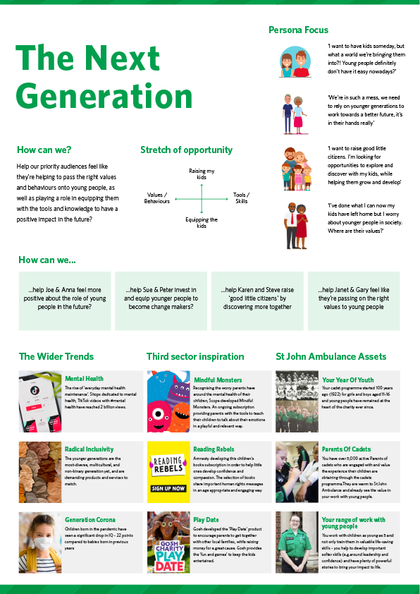
Notes:
Whilst I am not overly worried about rising costs for myself, I am conscious that there are people across the country who are struggling to pay bills and feed their families

Slide 3
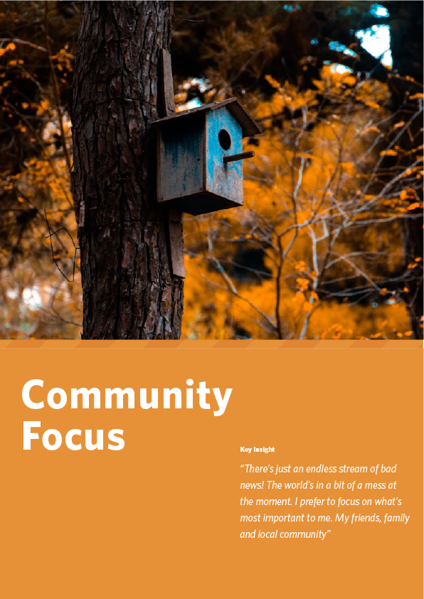
Notes:
Whilst I am not overly worried about rising costs for myself, I am conscious that there are people across the country who are struggling to pay bills and feed their families

Slide 4
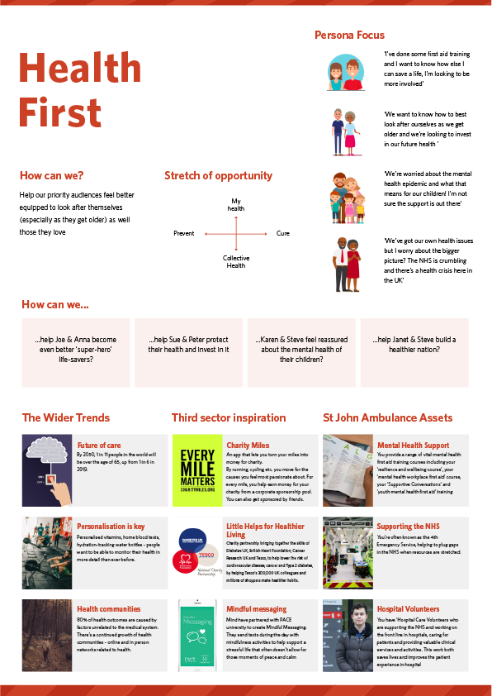
Notes:
Whilst I am not overly worried about rising costs for myself, I am conscious that there are people across the country who are struggling to pay bills and feed their families

Slide 5
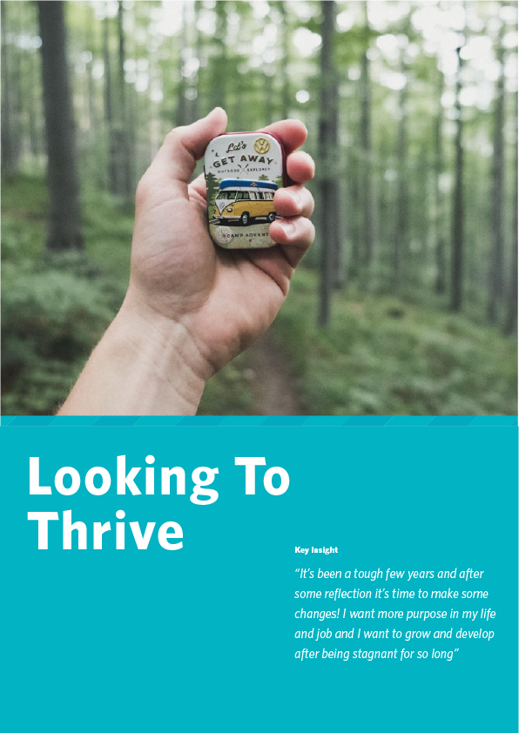
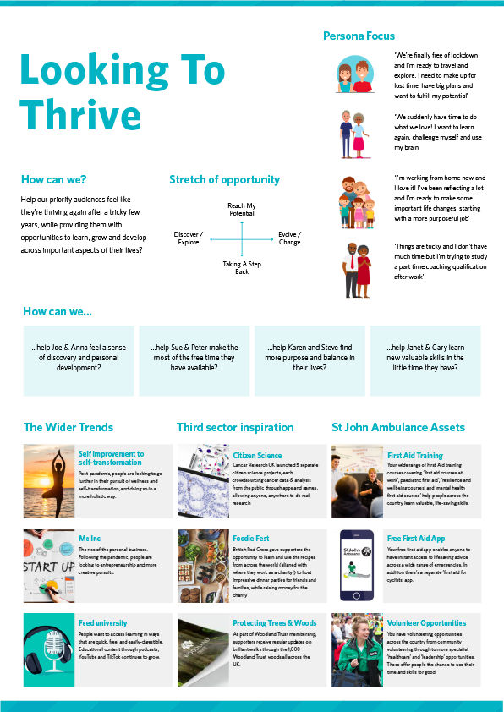
Notes:
Whilst I am not overly worried about rising costs for myself, I am conscious that there are people across the country who are struggling to pay bills and feed their families

