Slide 1
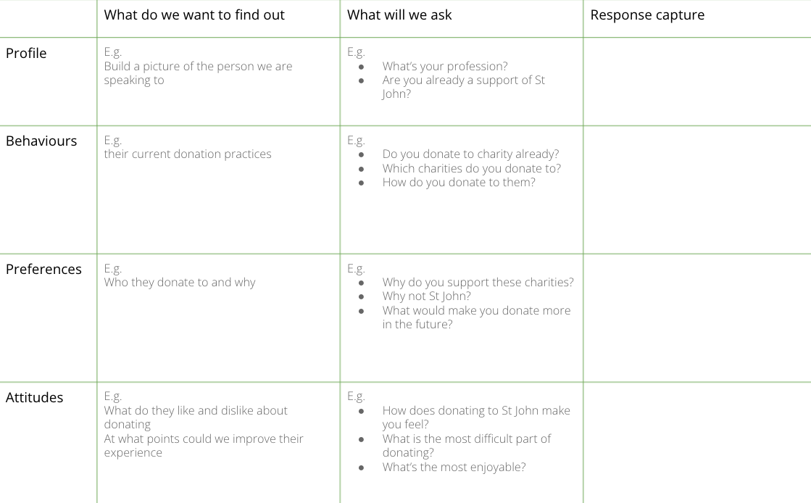
I want to understand why an audience looks and behaviours the way it does
to uncover the specific needs and frustrations we could target
AUDIENCE INTERVIEWS
What is it
Interviewing potential customers to get direct feedback on what they do and what motivates them. This activity is about asking open questions to explore the ‘why’ behind their behaviours and attitudes: what do they do and think? How does it make them feel?
When to use it
When you want to understand the ‘why’ behind some of the patterns you are observing. Collecting facts is not that useful - focus on the motivations, wants, needs and emotional drivers. Recruitment is key - having a really specific criteria helps and using a proper screening process to ensure you are speaking to the right people.
Learn More
READ : CrazyEgg’s guide to conducting customer interviews
LISTEN
The framework is made up of three parts
Recruitment briefs are used to inform agencies on who you need to speak to
Discussion guides are templates to steer the interviews with your audiences. They are not meant to be followed to the letter but should provide a structure to ensure all the key points are covered..
Insight capture sheets are used after the interview to capture the key themes, learnings and insights across multiple interviews
Notes:
How it makes them feel about themselves

Slide 2
THE TEMPLATE
AUDIENCE INTERVIEWS
There are three key things to prepare for audience interviews.
Recruitment briefs are used to inform agencies on who you need to speak to
Discussion guides are templates to steer the interviews with your audiences. They are not meant to be followed to the letter but should provide a structure to ensure all the key points are covered..
Insight capture sheets are used after the interview to capture the key themes, learnings and insights across multiple interviews
The discussion guide template gives examples of some of the questions to consider in a discussion guide.
The insight builder template provides a consistent and focused way to describe the insights you are uncovering (“I want/need…but…”)

Slide 3
HOW TO USE IT
AUDIENCE INTERVIEWS
STEP 1
Find people ideally around 8-10, but even speaking to 3-4 will be a big help.
STEP 2
Write discussion guide. First consider what you want to find out, then organise into a logical structure, then write open questions. The template provided might provide a useful guide.
STEP 3
Book in Teams / Zoom interviews and confirm with interviewees.
STEP 4
Complete interviews using your discussion guide to structure the conversation. Remember to probe with each question, using questions like “Why do you think that?” and ‘Can you say more about that?”. This will help you uncover the interviewee’s core emotional needs.
STEP 5
At the end of all interviews, scan the interviews and search for patterns and themes.
STEP 6
Write up these patterns as insight statements. Insight statements should include a want or need the audience needs addressing and a barrier that’s preventing them getting there. E.g. “I want to feel like a first-aid expert, but all the information available online feels dry and technical”

Slide 4
DISCUSSION GUIDE - AUDIENCE INTERVIEW
Use this template to plan a discussion guide for customer interviews. This is indicative of the sort of areas you might explore - each guide should be tailored for the specific interview and project.
 | What do we want to find out | What will we ask | Response capture
Profile | E.g. Build a picture of the person we are speaking to | E.g. What’s your profession? Are you already a support of St John?
Behaviours | E.g. their current donation practices | E.g. Do you donate to charity already? Which charities do you donate to? How do you donate to them?
Preferences | E.g. Who they donate to and why | E.g. Why do you support these charities? Why not St John? What would make you donate more in the future?
Attitudes | E.g. What do they like and dislike about donating At what points could we improve their experience | E.g. How does donating to St John make you feel? What is the most difficult part of donating? What’s the most enjoyable?
Notes:
STEP 1
Review the updated persona(s), customer journey(s), and interview notes.
(30 min)
STEP 2
Individually write down multiple actions, subjects, and outcomes. (10 min)
STEP 3
Jointly, make at least 5 combinations of possible HMW statements. (10 min)
STEP 4
Have a team discussion to decide on your innovation thesis, taking into consideration what this would mean in terms of potential solutions. (40 min)
Tip: Ask for feedback from an outsider

Slide 5
INSIGHT BUILDER
Use this template to create insight statements from the patterns you spot in the customer and/or expert interviews
ACTION you want to achieve (e.g. verb), SUBJECT to be influenced or affected, so that… WHAT you would like to ideally achieve (outcome)?
1. Want/need
The emotional state they want to reach
2. Pain point
The barrier that’s preventing them
I want/need…
…but…
I want/need…
…but…
I want/need…
…but…
I want/need…
…but…
I want/need…
…but…
I want/need…
…but…
Examples: “I want to feel like a first-aid expert, but all the information available online feels dry and technical”; “I want to feel like I’m doing my bit,, but being a working mum I find it hard to motivate myself without a target or goal”
Notes:
STEP 1
Review the updated persona(s), customer journey(s), and interview notes.
(30 min)
STEP 2
Individually write down multiple actions, subjects, and outcomes. (10 min)
STEP 3
Jointly, make at least 5 combinations of possible HMW statements. (10 min)
STEP 4
Have a team discussion to decide on your innovation thesis, taking into consideration what this would mean in terms of potential solutions. (40 min)
Tip: Ask for feedback from an outsider

