Slide 1
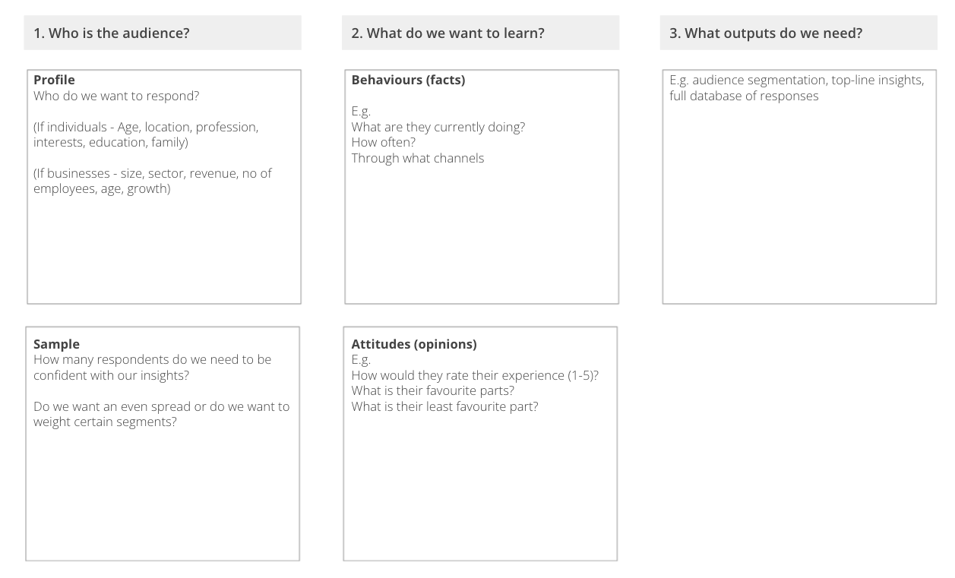
I want to gather a broad picture of the audiences we could serve To identify common patterns in attitudes and behaviours
AUDIENCE SURVEYS
What is it
A quantitative survey sent to a large sample of customers (typically 500-3000) who are representative of the customers you could serve through this project.
The survey aims to bring numerical data-points to specific questions around audience behaviours, attitudes and preferences.
When to use it
When you’re trying to identify broad patterns across your audience. When you want to understand audience segments and any differences amongst them. When want to identify the highest potential segment to target
Learn More
READ principles of quantitative research
The framework covers three areas
There are numerous ways to design a quant survey, but they typically include three types of question.
Demographic questions are factual questions about the person’s background. They are designed to create profiles of each individual, which can be used later to observe patterns and connections amongst similar groups
Behavioural questions are specific questions about the individual’s current behaviours. They are designed to build a picture of what the market currently looks like.
Attitudinal questions are subjective questions about the individual’s preferences, opinions, needs and frustrations. They are used to identify common needs and pain-points that can be targeted in the future.
Notes:
I want to write a crystal clear innovation brief
to ensure we are all aligned about what needs to be achieved, by whom and by when

Slide 2
THE TEMPLATE
AUDIENCE SURVEYS
There are numerous ways to design a quant survey, but they typically include three types of question.
Demographic questions are factual questions about the person’s background. They are designed to create profiles of each individual, which can be used later to observe patterns and connections amongst similar groups
Behavioural questions are specific questions about the individual’s current behaviours. They are designed to build a picture of what the market currently looks like.
Attitudinal questions are subjective questions about the individual’s preferences, opinions, needs and frustrations. They are used to identify common needs and pain-points that can be targeted in the future.

Slide 3
HOW TO USE IT
AUDIENCE SURVEYS
STEP 1
Connect with a quant research agency. Most agencies will have their own database and survey platform. They are also generally quite hands on in helping to design the survey and write questionnaires in the right way.
STEP 2
Send a survey brief to agency using the template
STEP 3
Work with the agency to design the survey and questionnaire. Consider the sample size required, who to screen in and out and what insights you are looking for.
STEP 4
Survey goes live. The questionnaire is sent to the database. People who did not fit the desired demographic profiles will be screened out. The survey is live until a representative sample of responses is reached. This could take between a few hours to a couple of days.
STEP 5
Analyse data and identify insights. Most agencies will offer data analysis and insight as part of their service. Depending on project budget, complexity and expertise, you may decide to handle some of this in-house.

Slide 4
AUDIENCE SURVEYS - AGENCY BRIEF
Use the questions below to brief quant research agencies and design quant survey
1. Who is the audience?
Profile
Who do we want to respond?
(If individuals - Age, location, profession, interests, education, family)
(If businesses - size, sector, revenue, no of employees, age, growth)
Sample
How many respondents do we need to be confident with our insights?
Do we want an even spread or do we want to weight certain segments?
2. What do we want to learn?
Behaviours (facts)
E.g.
What are they currently doing?
How often?
Through what channels
Attitudes (opinions)
E.g.
How would they rate their experience (1-5)?
What is their favourite parts?
What is their least favourite part?
3. What outputs do we need?
E.g. audience segmentation, top-line insights, full database of responses
Notes:
STEP 1
Review the updated persona(s), customer journey(s), and interview notes.
(30 min)
STEP 2
Individually write down multiple actions, subjects, and outcomes. (10 min)
STEP 3
Jointly, make at least 5 combinations of possible HMW statements. (10 min)
STEP 4
Have a team discussion to decide on your innovation thesis, taking into consideration what this would mean in terms of potential solutions. (40 min)
Tip: Ask for feedback from an outsider

