Slide 1
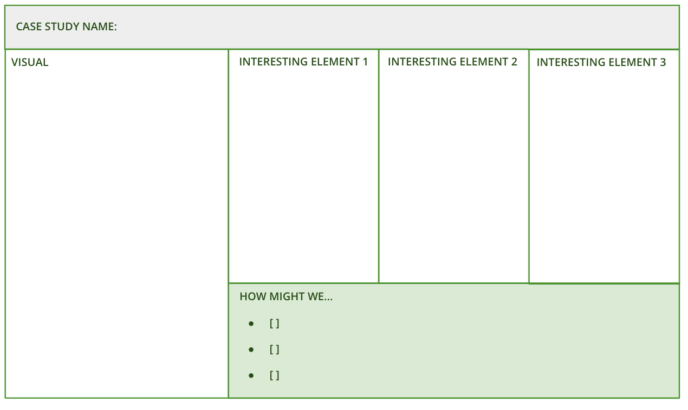
I want to use the best things already available in the market
To create new ideas that combine the best of the best
BEG BORROW STEAL
What is it
Beg Borrow Steal is an exercise designed to lift the best features from what’s already available and combine them into new products as a whole. The key is to create provocative and interesting stimulus that inspires the team and allows them to make unforeseen connections.
When to use it
When you want to generate new ideas in a market that is already quite competitive. When you are targeting an audience that is already well-served in this market or adjacent. When you want to create a best-in-class product, with the confidence that elements have been tried before
Learn More
READ - Miro’s brainstorming exercises
LISTEN - Stephen Gates’ brainstorming podcast episode
The stimulus template consists of three parts
The competitor:- who already serves this audience or need well
The element:- what part of their proposition is particularly effective or unusual
The ‘how might we…’:statement, used to prompt interesting comparisons or connections
Create 4+ per session

Slide 2
THE TEMPLATE
BEG, BORROW, STEAL
The stimulus template consists of three parts
The competitor: who already serves this audience or need well
The element: what part of their proposition is particularly effective or unusual
The ‘how might we…’: statement, used to prompt interesting comparisons or connections

Slide 3
HOW TO USE IT
BEG BORROW STEAL
STEP 1
Research.Identify 4 organisations to research and pull out 2 elements of their products that we could ‘beg, borrow or steal’ to help inform ours Start with competitors, then look further afield
STEP 2
Create stimulus. Pull out only the most interesting details and features from your research. Look for creative tidbits and unusual features, not vague product descriptions or full analysis. Use these to create provocative ‘how might we…?’ statements
Remember: generic stim makes generic ideas - make it punchy and precise. Better to be provocative (even a little hyperbolic) than bland.
STEP 3
Run an ideation session with the team. Introduce the case studies - remember, it’s more important to focus on the provocative parts of the proposition, rather than exploring their products as a whole
STEP 4
Each team member use the idea templates to combine their favourite parts of different ideas.
STEP 5
After the session, use the idea template to write up all the ideas into a consistent format.

Slide 4
BEG BORROW STEAL
Use the template to create stimulus for combining the best features from examples already out there. Find a minimum of 4 case studies, ideally from both in and out of the category
CASE STUDY NAME:
VISUAL
INTERESTING ELEMENT 1
INTERESTING ELEMENT 2
INTERESTING ELEMENT 3
HOW MIGHT WE…
[ ]
[ ]
[ ]

Slide 5
Idea Name:
IDEA TEMPLATE
Use this template to write up the winning ideas from idea generation activities
ELEVATOR PITCH
WHAT FEATURES DOES IT HAVE?
What’s the essence of the idea?
Describe the idea in more detail
CUSTOMER BENEFITS
FUNDING MODEL
What will they gain? What pains will it solve?
How will the idea make money?

