Slide 1
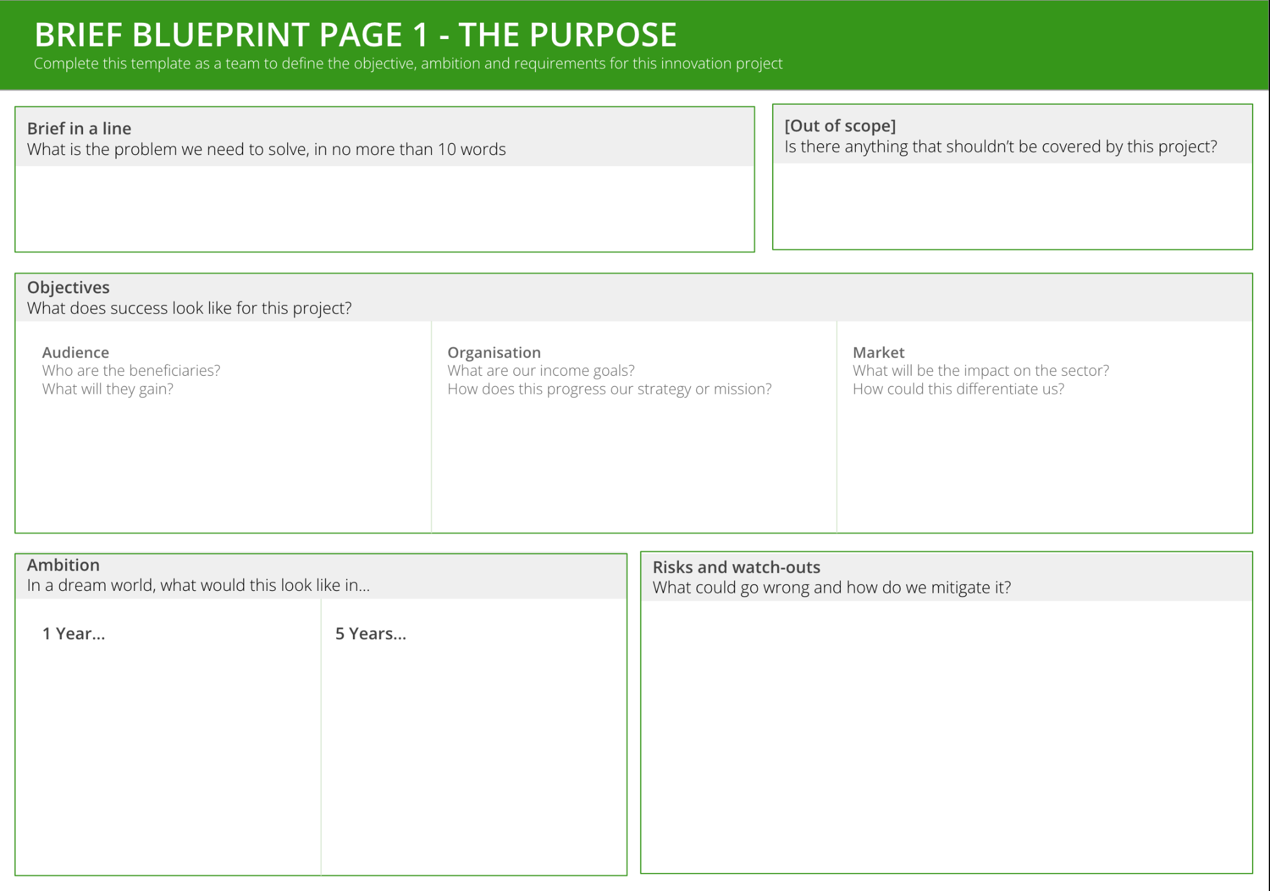
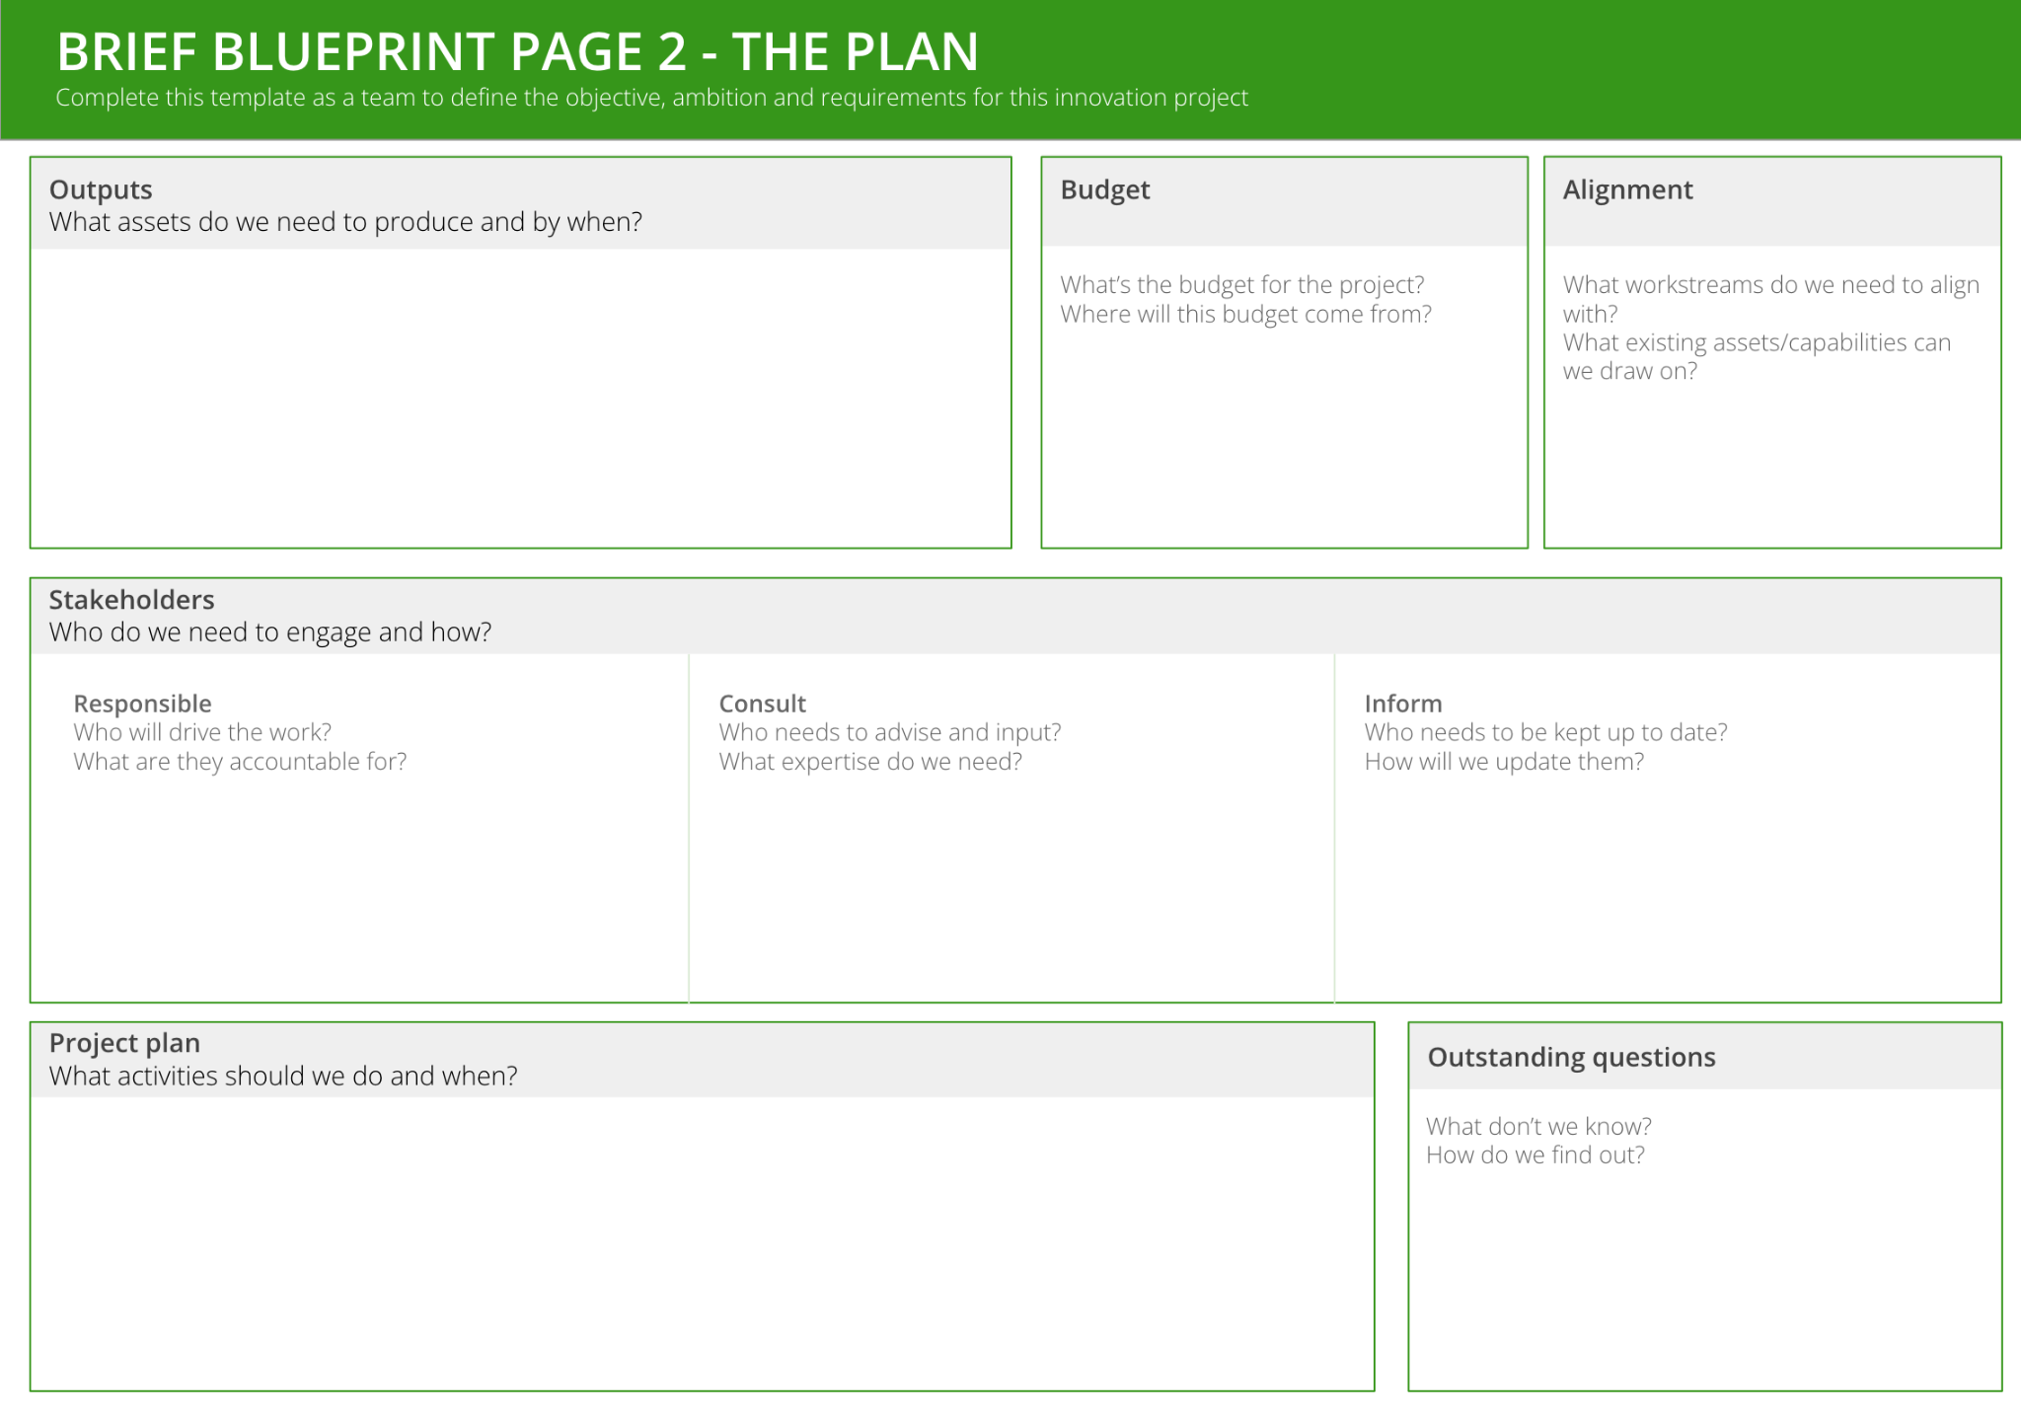
I want to write a crystal clear innovation brief
to ensure we are all aligned about what needs to be achieved, by whom and by when
BRIEF BLUEPRINT
What is it
A simple 3-page template guiding you through the key questions to ask before starting an innovation project. These questions will bring clarity, direction and momentum to the project
When to use it
When you’ve decided what your priorities are and you’re eager to get going
When you need to bring clarity and detail to the task at hand
Learn More
Watch: Gurulocity: Writing a project brief
The framework is made up of 3 sections
THE RATIONALE defines why this work is important
THE PURPOSE defines the objectives, impact and risks of the project
THE PLAN defines the outputs, timelines and engagement required

Slide 2
THE TEMPLATE
BRIEF BLUEPRINT
The framework is made up of 3 sections:
THE RATIONALE defines why this work is important
THE PURPOSE defines the objectives, impact and risks of the project
THE PLAN defines the outputs, timelines and engagement required

Slide 3
HOW TO USE IT
BRIEF BLUEPRINT
STEP 1
If you’re in-person, print the template on an A3 or A2 sheet of paper. Or if you’re running this virtually, create a Miro or Mural board for everyone to use. Best to use post-its to move ideas around as the discussion evolves.
STEP 2
Work through The Purpose template as a team. Some parts - such as ‘brief in a line’ and ‘out of scope’ - are best done by discussing and agreeing as a group. Other parts - such as ‘objectives’, ‘ambition’ and ‘risks’ - may be better done by individually using post-its initially, then share back as a group and agree which are the most important. Ensure everyone is aligned as much as possible before moving on.
TOP TIP: The best “briefs in a line” are often posed as a “How might we…” question, which specifies the asset, audience and desired objective: e.g. “How might we develop a value exchange product aimed at families that generates new income from our existing assets?”
STEP 3
Work through The Plan template as a group.
STEP 4
The project lead should write up a complete version of the brief and share with the rest of the team, with clear next steps and responsibilities (e.g. design a day-by-day project plan; set up stakeholder meetings)

Slide 4
BRIEF BLUEPRINT PAGE 1 - RATIONALE
Complete this template as a team to define the objective, ambition and requirements for this innovation project
Brief in a line
What is the problem we need to solve, in no more than 20 words
How might we…..
Context
Where has this brief come from? Why is it important now?
Learnings
What’s been tried in the past? What’s worked/hasn’t?
Barriers
What are the obstacles in our way?
Risks
What could go wrong and how do we mitigate it?

Slide 5
BRIEF BLUEPRINT PAGE 2 - OBJECTIVES
Complete this template as a team to define the objective, ambition and requirements for this innovation project
Outputs
What do we need to produce? By when?
Success metrics
What does success look like at the end of this project? How will we measure it?
Impact
What will this project achieve in the long-term?
 | 1 year | 5 years
Audience Who are the beneficiaries? What will they gain?
Organisation What are our income goals? How does this progress our strategy or mission?
Market What will be the impact on the sector? How could this differentiate us?

Slide 6
BRIEF BLUEPRINT PAGE 3 - PLAN
Complete this template as a team to define the objective, ambition and requirements for this innovation project
Boundaries
What’s out of scope for this project?
Budget
What’s the budget for the project?
Where will this budget come from?
Alignment
What workstreams do we need to align with?
What existing assets/capabilities can we draw on?
Stakeholders
Who needs to be involved and how?
Decision making
Who is the decision maker?
What is the sign-off process?
Responsible
Who will drive the work?
What are they accountable for?
Consult
Who needs to advise and input?
What expertise do we need?
Inform
Who needs to be kept up to date?
How will we update them?
High-level Project plan
How can you break the project into 3-4 phases? What are the activities and outputs for each phase?
Outstanding questions
What don’t we know?
How do we find out?
Notes:
How might we XXX
Rationale for focus
Objective
Success criteria (project)
Value
Risks
Boundaries
Methodology
Outputs / deliverables

