Slide 1
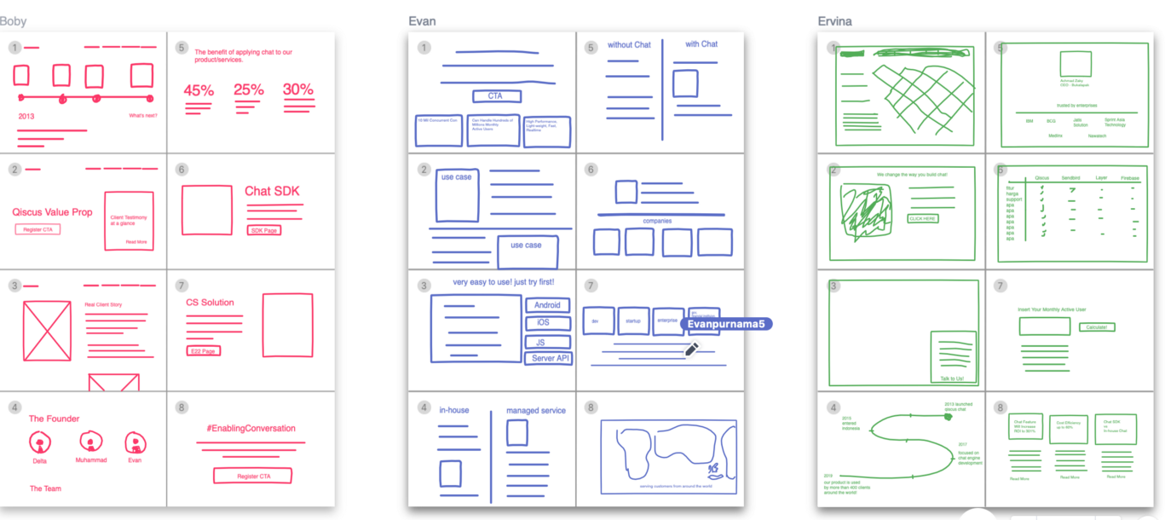
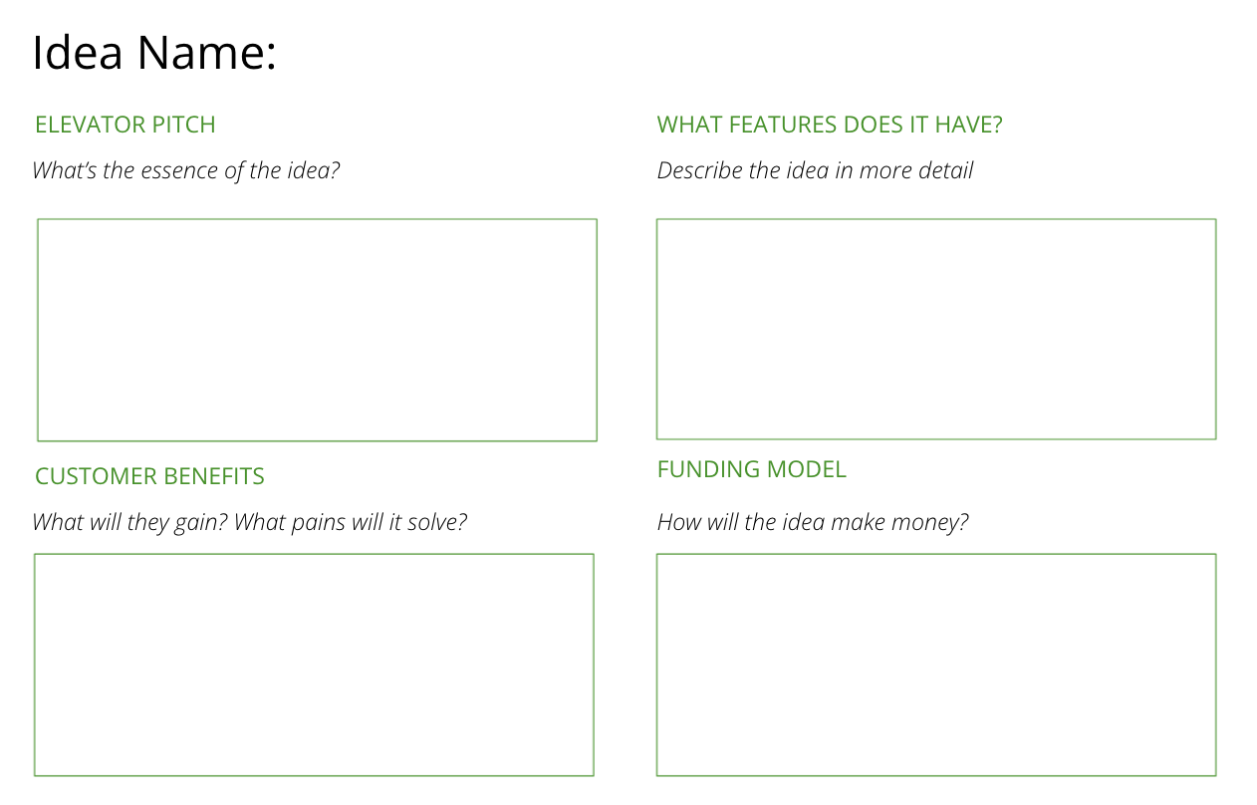
I want to quickly generate as many ideas as possible...
To move beyond my initial hunches and begin thinking more creatively
CRAZY EIGHTS
What is it
Crazy 8’s is a core Design Sprint method. It is a fast sketching exercise that challenges people to sketch eight distinct ideas in eight minutes. The goal is to push beyond your first idea, frequently the least innovative, and to generate a wide variety of solutions to your challenge.
After sketching your 8 ideas on a blank sheet of paper, write up the best ideas using the idea template
When to use it
Prerequisite: You have to have a problem. The problem is the reason behind your challenge - use the ‘How might we’ builder tool to establish your problem.
It’s important that everyone uses the same template to ensure all ideas are comparable and at the same level of detail.
Template
Click here
Learn More
READ - Miro’s brainstorming exercises
LISTEN - Stephen Gates’ brainstorming podcast episdoe
There are four parts of the idea template (to write up the winning ideas)
Idea name: Describe the idea in a word or phrase
Idea in a line: What’s the essence of the idea?
Features: What are the components of the idea?
Customer benefit: What will they gain? What pains will it solve?
Income model: How will the idea make money?

Slide 2
THE TEMPLATE
CRAZY EIGHTS
There are four parts of the idea template (to write up the winning ideas)
Idea name: Describe the idea in a word or phrase
Elevator pitch: What’s the essence of the idea?
Features: What are the components of the idea?
Customer benefit: What will they gain? What pains will it solve?
Income model: How will the idea make money?

Slide 3
HOW TO USE IT
CRAZY EIGHTS
STEP 1
Prepare the session. Write some ‘how might we…?’ questions using the insights gathered earlier in the project that will be used to create ideas.
STEP 2
Gather a variety of people in the room. Bring everyone up to speed on where you are in the project and the purpose of the session. Emphasise this is about being creative and open-minded. Stress that this is about going wide, not deep. If there’s time, run a short 5 minute energiser to get the creative juices flowing - this works well with activities like these.
STEP 3
Set the challenge of coming up with 8 ideas in 15 minutes. Set a timer to give a 5 minute and 1 minute warning
STEP 4
Each team member present their best and craziest ideas back
STEP 5
At the end of the session, everyone vote on their favourite ideas.
STEP 6
After the session, write up the winning ideas using the Idea template

Slide 4
CRAZY EIGHTS
Use the template to sketch out 8 different ideas in 8 minutes

Slide 5
Idea Name:
IDEA TEMPLATE
Use this template to write up the winning ideas from idea generation activities
ELEVATOR PITCH
WHAT FEATURES DOES IT HAVE?
What’s the essence of the idea?
Describe the idea in more detail
CUSTOMER BENEFITS
FUNDING MODEL
What will they gain? What pains will it solve?
How will the idea make money?

