Slide 1
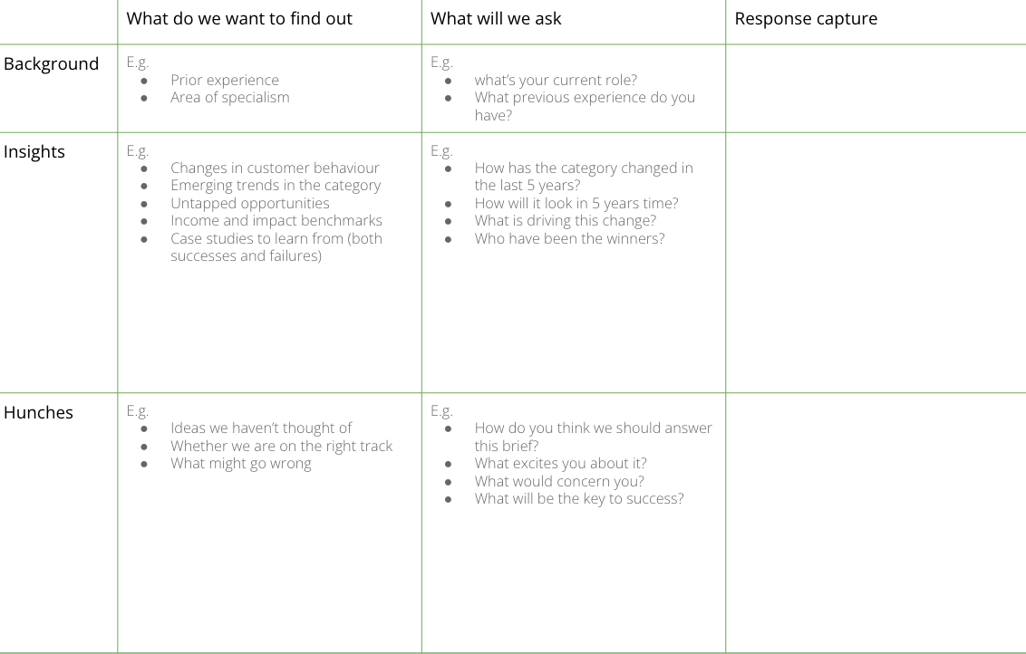
I want to collect input from experts
to understand what’s going on in the market and what best practice looks like
EXPERT INTERVIEWS
What is it
Speaking to experts in the product category / area you’re innovating in to learn from their experience and shortcut your learnings. People like to be called experts and share their knowledge so you often get a good response even when reaching out cold.
When to use it
When you’re trying to better understand the audience, the market and where the gaps are. You can also use expert interviews to stress test existing ideas or hunches, and identify some of your blind spots
Experts can come from within your network/organisation, or can be recruited externally through expert recruitment agencies.
The framework is made up of 3 sections:
Discussion guides are only meant to be a guide - it’s fine to be flexible and explore interesting topics as they come up. Just make sure you cover all the key things you need to.
BACKGROUND questions are about getting a full idea on the interviewee’s experience and background. These should be 5% interview.
INSIGHT questions are about getting as much information and expertise as possible about the market, audience and organisation. These should be 75-80% interview
HUNCH questions are about getting their initial and instinctive hypotheses about what solutions could be. These should be 15-20% of the interview.

Slide 2
THE TEMPLATE
EXPERT INTERVIEWS
Discussion guides are only meant to be a guide - it’s fine to be flexible and explore interesting topics as they come up. Just make sure you cover all the key things you need to.
Typically, there are three types of question to include.
BACKGROUND questions are about getting a full idea on the interviewee’s experience and background. These should be 10% interview.
INSIGHT questions are about getting as much information and expertise as possible about the market, audience and organisation. These should be 70% interview
HUNCH questions are about getting their initial and instinctive hypotheses about what solutions could be. These should be 20% of the interview.

Slide 3
HOW TO USE IT
EXPERT INTERVIEWS
STEP 1
Identify the right expert. Start by scouring St John’s network, or use an expert recruiter.
STEP 2
Write discussion guide. Start by listing the key things you want to uncover. Then organise them into a logical flow (e.g. start with broad/contextual topics, and get more granular as you go). Then write open questions to explore each topic.
STEP 3
Book in Teams / Zoom interviews and confirm with interviewees. With their permission, you may want to record the interview.
STEP 4
Complete interviews using your discussion guide to structure the conversation. Fill in direct quotes as you go. Immediately after each conversation, ensure all insights were captured.
STEP 5
At the end of all interviews, synthesise common themes and key findings into insights.

Slide 4
DISCUSSION GUIDE - EXPERT INTERVIEW
Use this template to plan a discussion guide for expert interviews. This is indicative of the sort of areas you might explore - each guide should be tailored for the specific interview and project.
 | What do we want to find out | What will we ask | Response capture
Background | E.g. Prior experience Area of specialism | E.g. what’s your current role? What previous experience do you have?
Insights | E.g. Changes in customer behaviour Emerging trends in the category Untapped opportunities Income and impact benchmarks Case studies to learn from (both successes and failures) | E.g. How has the category changed in the last 5 years? How will it look in 5 years time? What is driving this change? Who have been the winners?
Hunches | E.g. Ideas we haven’t thought of Whether we are on the right track What might go wrong | E.g. How do you think we should answer this brief? What excites you about it? What would concern you? What will be the key to success?
Notes:
STEP 1
Review the updated persona(s), customer journey(s), and interview notes.
(30 min)
STEP 2
Individually write down multiple actions, subjects, and outcomes. (10 min)
STEP 3
Jointly, make at least 5 combinations of possible HMW statements. (10 min)
STEP 4
Have a team discussion to decide on your innovation thesis, taking into consideration what this would mean in terms of potential solutions. (40 min)
Tip: Ask for feedback from an outsider

