Slide 1
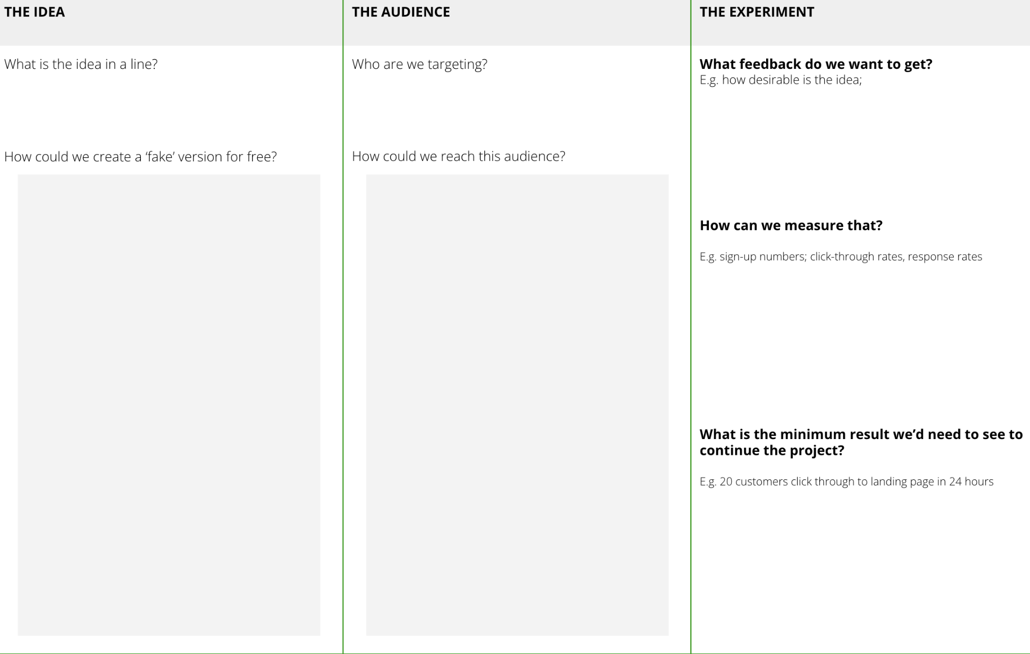
I want to get feedback on a fake version of my idea
To get proof there is market demand before spending more time and money
FAKE IT BEFORE YOU MAKE IT
What is it
This is a ‘cheat code’ to test whether your idea has legs before you start investing time and money in making anything concrete. This activity is about creating a ‘fake’ version of your innovation that you can put out into the world and see if your audience is interested. It might be a smokescreen advert on Facebook, a newsletter sign-up invitation, some leaflets to hand out at an event, or something else.
When to use it
When you want to get an initial indication of whether there is a demand for your innovation.
Tools
Below are some intuitive and free tools to help you create prototypes
Mockuper - create mock-up visuals (e.g. a webpage, mobile image)
Invision - create mock-up apps
This template has three parts
The Idea - brainstorming how you can create a fake version of the idea
The Channel - brainstorming how you can get this idea in front of your target audience
The Experiment - defining what feedback you are looking for and how to measure it

Slide 2
THE TEMPLATE
FAKE IT BEFORE YOU MAKE IT
This template can help you plan how you might ‘fake it before you make it’.
It has three parts.
The Idea - brainstorming how you can create a fake version of the idea
The Channel - brainstorming how you can get this idea in front of your target audience
The Experiment - defining what feedback you are looking for and how to measure it

Slide 3
HOW TO USE IT
FAKE IT BEFORE YOU MAKE IT
The specific activity you do to test a fake version of the idea entirely depends on what makes sense for the idea.
Three classic examples are:
FACEBOOK ADVERT TO A LANDING PAGE
‘FAKE’ SALES LEAFLETS
POP UP RETAIL
STEP 1
Create a fake advert on Facebook. This could simply be a product mock-up and some blurb about the features and its key benefits.
STEP 2
Create a basic landing page for the product, with a message saying “Product in Development. Coming Soon!”
STEP 3
Publish the advert on Facebook, targeting your chosen audience
STEP 4
Track click-through to the landing page using Analytics. Does there seem to be interest in this idea?
STEP 1
Create a fake sales leaflets for the product
STEP 2
Identify where your key audience gather. If general public, this could simply be on the streets outside. More niche audiences might gather in certain spaces or certain events
STEP 3
Spend half a day at these places handing out leaflets
STEP 4
Track how many leaflets are distributed and general audience responses. Does there seem to be interest in the idea?
STEP 1
Use sites like Appear Here to find a retail space (market stall or shop) for hire near you
STEP 2
Arrange to hire the space for between a day and a week
STEP 3
Take a prototype of the product (and any others in your innovation pipeline) and see how many you can sell!
STEP 4
Track interest and conversion throughout the period. Does there seem to be interest in this product?

Slide 4
FAKE IT BEFORE YOU MAKE IT
Use this template to brainstorm ways you can test a ‘fake’ version of your idea to test if there is audience demand
THE IDEA
THE AUDIENCE
THE EXPERIMENT
What is the idea in a line?
Who are we targeting?
What feedback do we want to get?
E.g. how desirable is the idea;
How can we measure that?
E.g. sign-up numbers; click-through rates, response rates
What is the minimum result we’d need to see to continue the project?
E.g. 20 customers click through to landing page in 24 hours
How could we create a ‘fake’ version for free?
How could we reach this audience?

