Slide 1
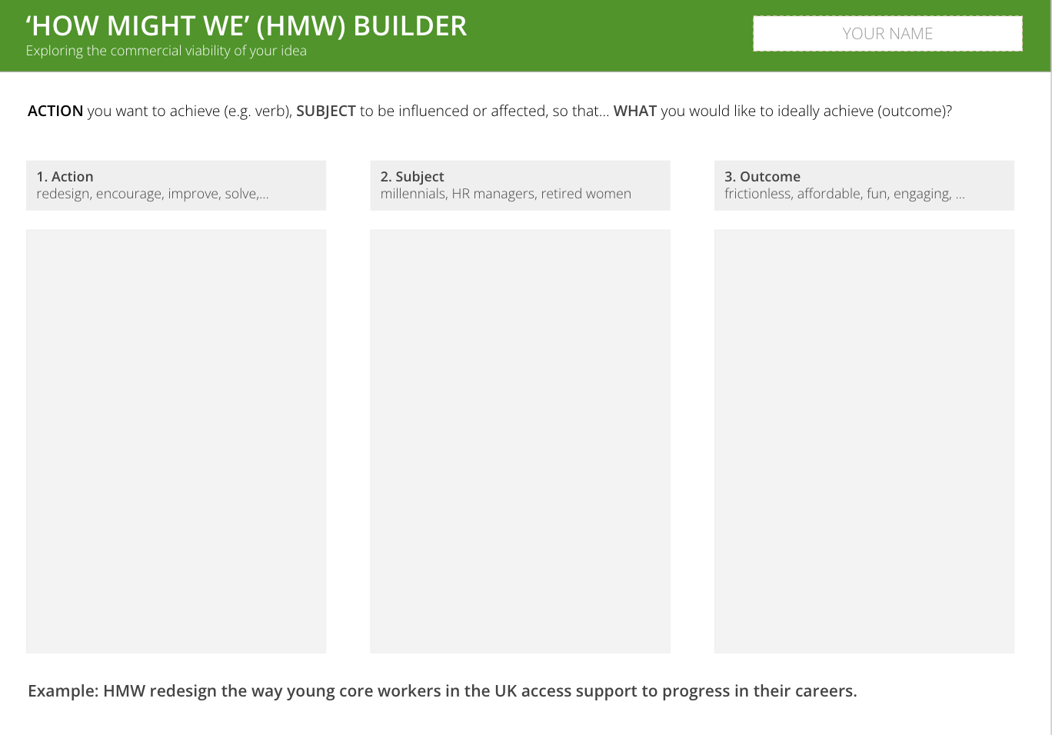
I want to create provocative briefs
To stimulate new ideas and discussion
HOW MIGHT WE BUILDER
What is it
A simple 3-part template to create a range of open questions that help to step out of the weeds and take a fresh look at a problem or opportunity you face
When to use it
‘How Might We…’ questions are used throughout the innovation process whenever you want to take a fresh and creative look at something. They are helpful early on to help flush out all the initial hypotheses and hunches the team has. They can also be repurposed later on when you want to improve ideas or see how far they can stretch to different purposes and audiences
Learn More
READ - Convene’s guide to preparing brainstorming
There are three parts to the template
How Might We…
[Action: what you want to do]
[Subject: who you want to do it do]
[Outcome: what you want to achieve]

Slide 2
THE TEMPLATE
HOW MIGHT WE BUILDER
There are three parts to the template
How Might We…
[Action: what you want to do]
[Subject: who you want to do it do]
[Outcome: what you want to achieve]

Slide 3
HOW TO USE IT
HOW MIGHT WE BUILDER
STEP 1
Print out template or copy it on Miro/Mural
STEP 2
Brainstorm all the possible Actions (verbs) that would be relevant for this brief. Add them as post-its.
STEP 3
Brainstorm all the possible Subjects (audiences/assets) that would be relevant for this brief. Add them as post-its.
STEP 4
Brainstorm all the possible Outcomes that would be relevant for this brief. Add them as post-its.
STEP 5
Experiment with different combinations. Write up your top 5 How Might We… questions
STEP 6
Use these questions as stimulus in an idea generation workshop

Slide 4
‘HOW MIGHT WE’ (HMW) BUILDER
Use this template to create provocative briefs to stimulate idea generation
ACTION you want to achieve (e.g. verb), SUBJECT to be influenced or affected, so that… WHAT you would like to ideally achieve (outcome)?
1. Action
redesign, encourage, improve, solve,…
2. Subject
millennials, HR managers, retired women
3. Outcome
frictionless, affordable, fun, engaging, …
Example: HMW redesign the way young core workers in the UK access support to progress in their careers.
Notes:
STEP 1
Review the updated persona(s), customer journey(s), and interview notes.
(30 min)
STEP 2
Individually write down multiple actions, subjects, and outcomes. (10 min)
STEP 3
Jointly, make at least 5 combinations of possible HMW statements. (10 min)
STEP 4
Have a team discussion to decide on your innovation thesis, taking into consideration what this would mean in terms of potential solutions. (40 min)
Tip: Ask for feedback from an outsider

