Slide 1
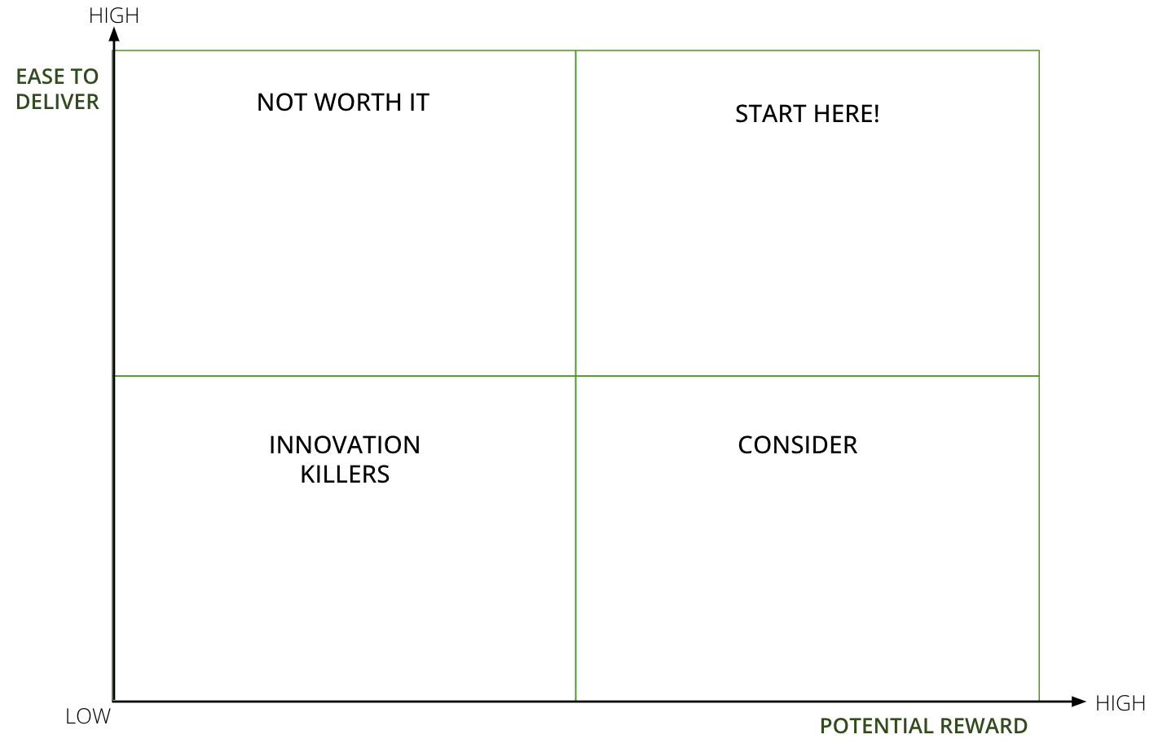
I want to map out and prioritise my teams innovation projects.
to ensure we know where to start next and why.
INNOVATION BATTLEFIELD
What is it
A simple 2 x 2 tool to plot your various innovation opportunities, and prioritise which ones to work on first.
The matrix gets you to plot ideas against effort versus reward, allowing you to quickly pinpoint the high reward, low effort opportunities.
When to use it
When you’re setting budgets, designing your team’s innovation pipeline and roadmap. If you’re stuck on what to work on next and why, and you need a quick way to get everyone aligned on where to focus and why.
Template
Click here
Learn More
READ Innovation strategy tools, best practice & examples
The framework is made up of 4 sections:
START HERE are the high-value, low-effort opportuniites. They should be prioritised first
CONSIDER are the high value, high-effort opportunities. They should be considered second, with discussion around feasibility and risk
NOT WORTH IT are the low-value, low-effort opportunities. They shouldn’t be prioritised
INNOVATION KILLERS are the low-value, high-effort opportunities. They should be killed or discounted from the pipeline..

Slide 2
HOW TO USE IT
INNOVATION BATTLEFIELD
STEP 1
If you’re in-person, print the template on an A3 or A2 sheet of paper. Or if you’re running this virtually, create a Miro or Mural board for everyone to use. Best to use post-its to move ideas around as the discussion evolves.
STEP 2
Have your team’s long list of potential innovation opportunities to hand.and your latest strategy to refer to. Develop a simple criteria to score each idea against both reward (i.e. income potential / cost or time saving / potential impact), and ease to deliver (i.e. cost to deliver / time to deliver / fit against existing systems and processes, reliance on other teams or external support).
STEP 3
Score each opportunity against the criteria, with each category ranging from 1-5. Add up the scores for each opportunity. You’ll relying on gut instinct at this stage, but if there are real sticking points, take the question away and agree who’ll explore it.
STEP 4
Plot the ideas up on the 2xs2, and agree which ones you’ll work on first.

Slide 3
INNOVATION BATTLEFIELD
Use this tool to prioritise opportunities by reward (income or impact) and ease (time, complexiity, capabilitity)
HIGH
EASE TO DELIVER
NOT WORTH IT
START HERE!
INNOVATION KILLERS
CONSIDER
LOW
HIGH
POTENTIAL REWARD

