Slide 1
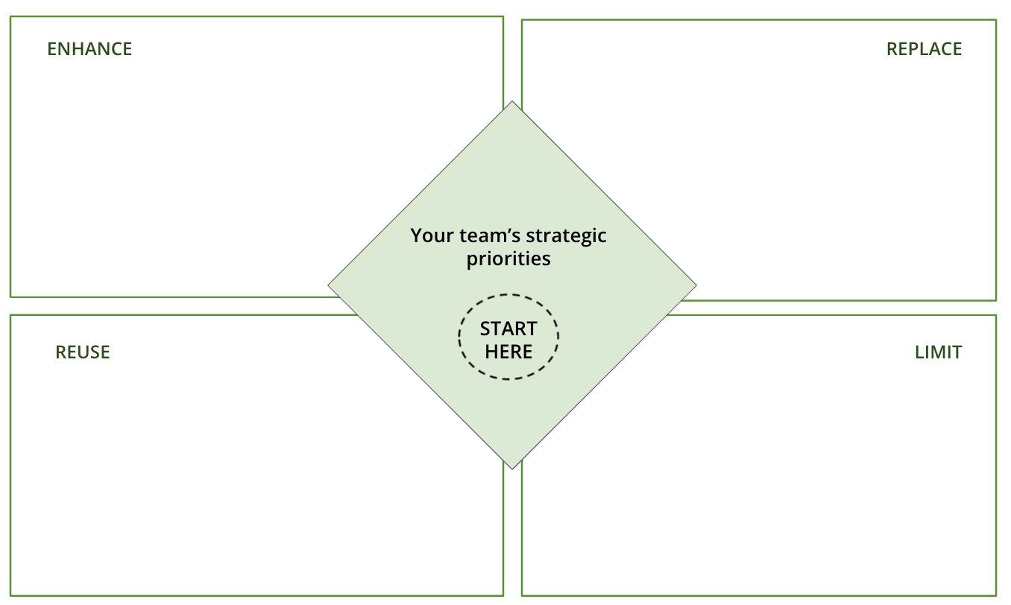
I want to uncover all the ideas, opportunities and challenges within my team to identify possible innovation briefs we could set
OPPORTUNITY MAP
What is it
A 1-page template that you and your team can use to generate a long list of innovation opportunities
When to use it
When you’re stuck for innovation ideas, looking to fill your pipeline, or you need a simple way to categorise your existing ideas.
How to use it
You and your team can complete the template in a scrappy one-hour workshop or a more comprehensive half day planning meeting - either way, you’ll get a list of ideas ranging from quick wins to longer-term strategic opportunities.
Learn More
WATCH: Building an innovation pipeline in an ambidextrous organisation READ : Making sense of innovation pipelines, portfolios and funnels
The framework is made up of 4 sections:
ENHANCE for example optimising a supporter journey on an existing product, experimenting with a new marketing and acquisition campaign, or streamlining an existing process to save time.
REUSE for example testing a new route to market for an existing product, or adapting it for a different audience.
REPLACE for example creating new products for existing and new audiences, or taking an existing process and changing it to save time or money,
LIMIT what will you stop doing? For example cutting back on the investment in an declining product to free up time,

Slide 2
THE TEMPLATE
OPPORTUNITY MAP
The framework is made up of 4 sections:
ENHANCE for example optimising a supporter journey on an existing product, experimenting with a new marketing and acquisition campaign, or streamlining an existing process to save time.
REUSE for example testing a new route to market for an existing product, or adapting it for a different audience.
REPLACE for example creating new products for existing and new audiences, or taking an existing process and changing it to save time or money,
LIMIT what will you stop doing? For example cutting back on the investment in an declining product to free up time,

Slide 3
HOW TO USE IT
OPPORTUNITY MAP
STEP 1
Download this template and print enough copies for each person on A4 paper. Or if you’re doing this virtually, set up a Miro or Mural board and share with everyone taking part. You’ll need a copy of this template for each person,
STEP 2
Have your team’s latest strategy to hand. Any data you have on the current performance of existing products, or a list of ideas from your competitors will help get people thinking,
STEP 3
Show everyone the template, and explain what each section means and how the activity works. Give them an example under each category. Encourage them to think creatively and get as many ideas down as possible.
STEP 4
Get each team member to spend 2-3 minutes per category developing a list of ideas under each category - 1 idea per post-it note. Once they’re done, put them in pairs or 3s, and give them 20 minutes to share back and discuss.
STEP 5
Give each group a further five minutes to select their top 5 ideas and mark them clearly. Finish by getting each person to share 1 of their top 5s. Take this long list of top 5s away and write them up as briefs.

Slide 4
OPPORTUNITY MAP
Use this tool to uncover and collect all the innovation opportuniites you’ve noticed
NAME
ENHANCE
REPLACE
YOUR TEAM’S STRATEGIC PRIORITIES
START
HERE
REUSE
LIMIT

