Slide 1
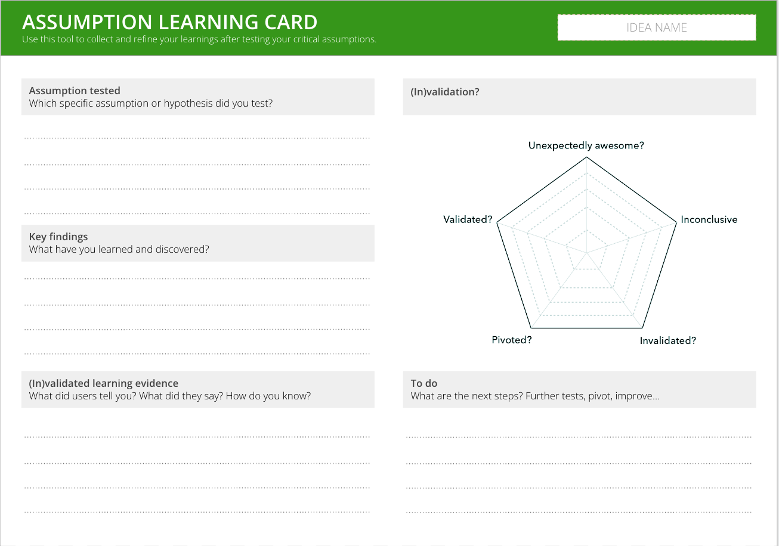
I want to test of the idea before launching it
To test its feasibility and refine the product based on real-world feedback
PROTOTYPING
What is it
An iterative process of building, testing and improving your idea at increasing levels of detail and confidence. It starts by creating the most basic version of a product and testing if customers want it, and layering up features and assumptions in stages until you have reached proof that the idea could work and generate income.
When to use it
When you want to take an evidence-led approach to deciding whether to launch a pilot or not.
Tools
Below are some intuitive and free tools to help you create and test prototypes
Mockuper - create mock-up visuals (e.g. a webpage, mobile image)
Invision - create mock-up apps
MailChimp - create pretend campaigns
SurveyMonkey - to run surveys for audience testing
This template will help you plan and respond to prototype testing
Assumptions are the things that need to be true for the idea to work. They should be as specific as possible - instead of ‘will it make money’, it might be “can we drive traffic to our website and get people to click ‘buy’
Key findings is a summary of what you’ve learned from the test
Validation is a reflection of whether the assumption has been proved or disproved.

Slide 2
THE TEMPLATE
PROTOTYPING
There are two templates to help you prototype.
The Assumption Learning Card captures specific feedback on the idea, usually about whether the idea could work or make money. It helps you test if the idea is feasible.
The Audience Feedback form captures general feedback on the idea as a whole. It helps you test if the idea is desirable.

Slide 3
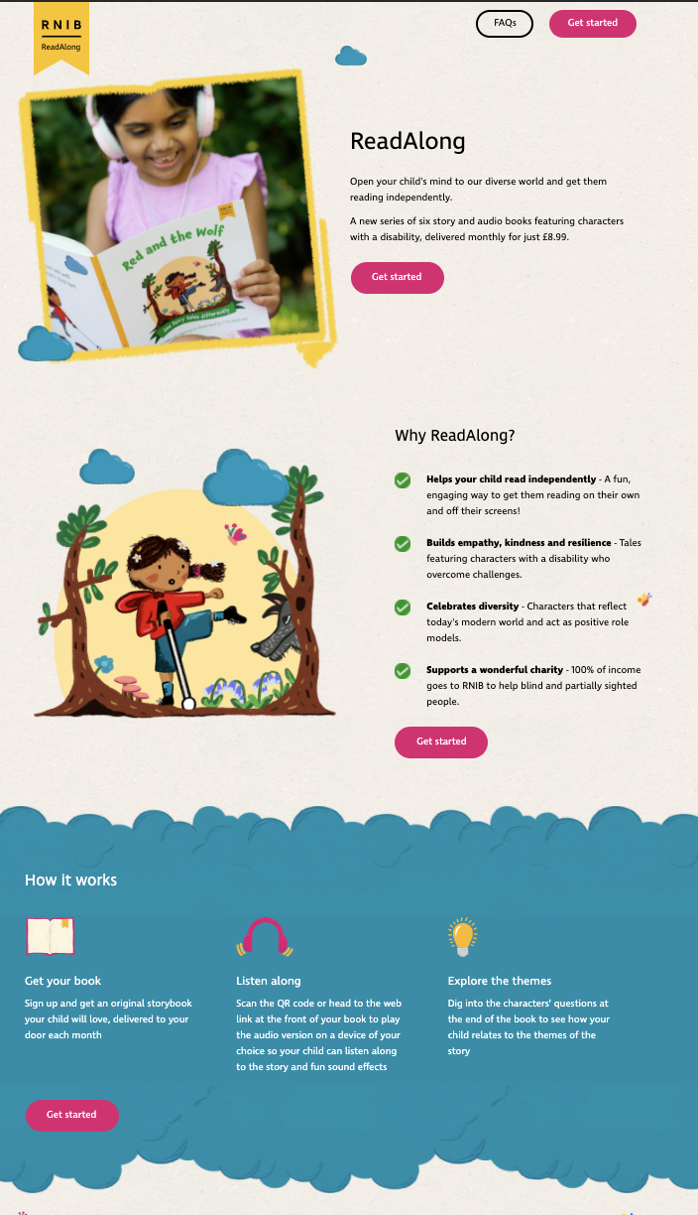
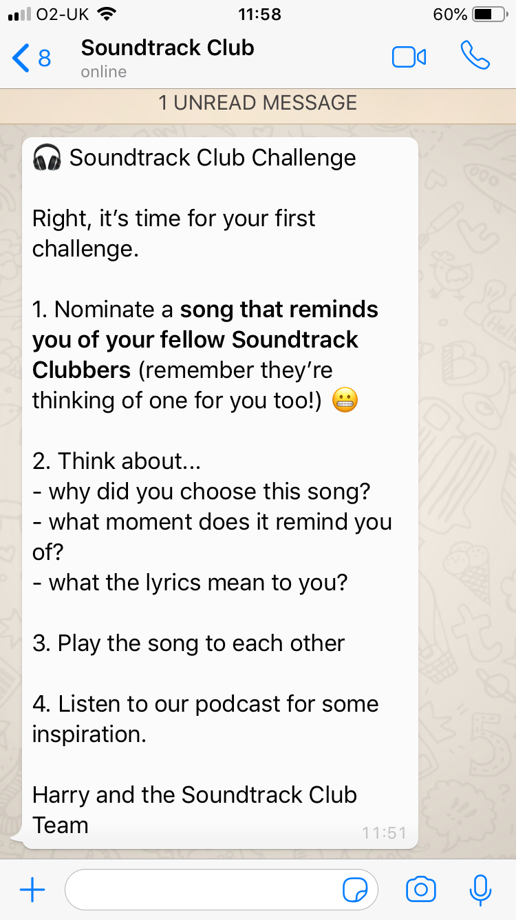
HOW TO USE IT
PROTOTYPING
Prototyping happens in three stages before a full pilot.
MINIMUM MARKETABLE PRODUCT
MINIMUM TESTABLE PRODUCT
MINIMUM SELLABLE PRODUCT
PILOT
Only the ‘shop window’ - enough to show someone what your product could be (before you build it).
The smallest set of features required that provide value to the customer. It’s something that you can put in a customers /users 'hands’ and get them to use or experience it.
The version of your product built with ‘sticks and sellotape’. It is good enough to allow real people to sign up and donate / pay to receive the product or experience.
Launching a new idea to market to validate it; would usually be at minimal investment levels sufficient to test at a reasonable scale, to inform scope for rollout and subsequent increased investment
Notes:
STEP 1
Define the assumptions or hypotheses you’re testing.
STEP 2
Run your experiment (see experiment cards) and write down your key learnings and insights.
STEP 3
Write down in what way your validations held true – or didn’t. Write down the evidence you have for this (in)validation.
STEP 4
Complete the spider diagram to show how much (in)validation you obtained on this particular assumption. Ask yourself if you need to run further or broader experiments on this particular assumption.
STEP 5
Define clear next steps. Perhaps you need further validated learning evidence or need to test new assumptions that emerged as a result. Either way, clearly define your next steps

Slide 4
HOW TO USE IT
ASSUMPTION TESTING
STEP 1
Define the assumptions or hypotheses you’re testing.
STEP 2
Run your experiment and write down your key learnings and insights.
STEP 3
Write down in what way your validations held true – or didn’t. Write down the evidence you have for this (in)validation.
STEP 4
Complete the spider diagram to show how much (in)validation you obtained on this particular assumption. Ask yourself if you need to run further or broader experiments on this particular assumption.
STEP 5
Define clear next steps. Perhaps you need further validated learning evidence or need to test new assumptions that emerged as a result. Either way, clearly define your next steps
Notes:
STEP 1
STEP 2
STEP 3
STEP 4
STEP 5

Slide 5
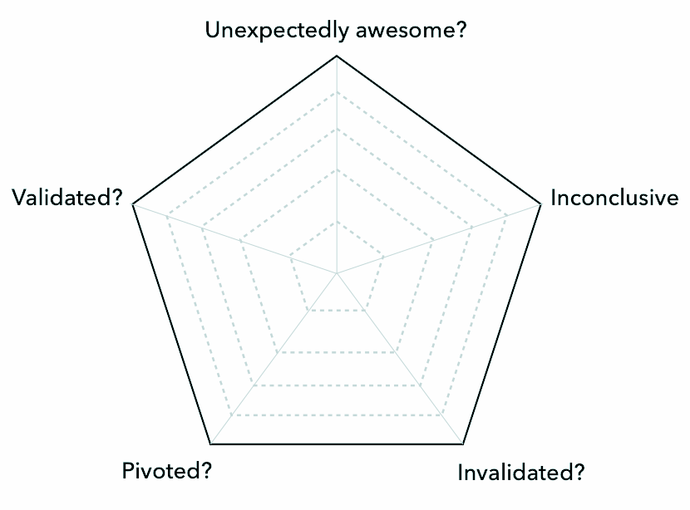
ASSUMPTION LEARNING CARD
Use this tool to collect and refine your learnings after testing your critical assumptions.
IDEA NAME
Assumption tested
Which specific assumption or hypothesis did you test?
(In)validation?
Key findings
What have you learned and discovered?
(In)validated learning evidence
What did users tell you? What did they say? How do you know?
To do
What are the next steps? Further tests, pivot, improve…
Notes:
STEP 1
Define the assumptions or hypotheses you’re testing.
STEP 2
Run your experiment (see experiment cards) and write down your key learnings and insights.
STEP 3
Write down in what way your validations held true – or didn’t. Write down the evidence you have for this (in)validation.
STEP 4
Complete the spider diagram to show how much (in)validation you obtained on this particular assumption. Ask yourself if you need to run further or broader experiments on this particular assumption.
STEP 5
Define clear next steps. Perhaps you need further validated learning evidence or need to test new assumptions that emerged as a result. Either way, clearly define your next steps

Slide 6
HOW TO USE IT
AUDIENCE FEEDBACK
STEP 1
Arrange a 1-1 or 2-1 interview with somebody in your target audience or an expert
STEP 2
Share the prototype with them. This could be a simple sketch or something more concrete (MMP, MTP, MSP).
STEP 3
Ask them open questions about the idea, e.g. “What do you think of this? How might you use it? What do you like/dislike most?”
STEP 4
Capture feedback as you go.
STEP 5
After the interview, synthesise the key feedback and fill out the audience feedback form
Notes:
STEP 1
STEP 2
STEP 3
STEP 4
STEP 5

Slide 7
AUDIENCE FEEDBACK CAPTURE
Use this template to capture feedback on ideas or propositions from customers or experts
WHAT WORKED?
WHY?
WHAT SURPRISED YOU?
WHY?
OTHER NOTES
WHAT DIDN’T WORK?
WHY?
WHAT NEW IDEAS DID THEY ADD?
WHY?
Notes:
STEP 1
Review the updated persona(s), customer journey(s), and interview notes.
(30 min)
STEP 2
Individually write down multiple actions, subjects, and outcomes. (10 min)
STEP 3
Jointly, make at least 5 combinations of possible HMW statements. (10 min)
STEP 4
Have a team discussion to decide on your innovation thesis, taking into consideration what this would mean in terms of potential solutions. (40 min)
Tip: Ask for feedback from an outsider

