Slide 1
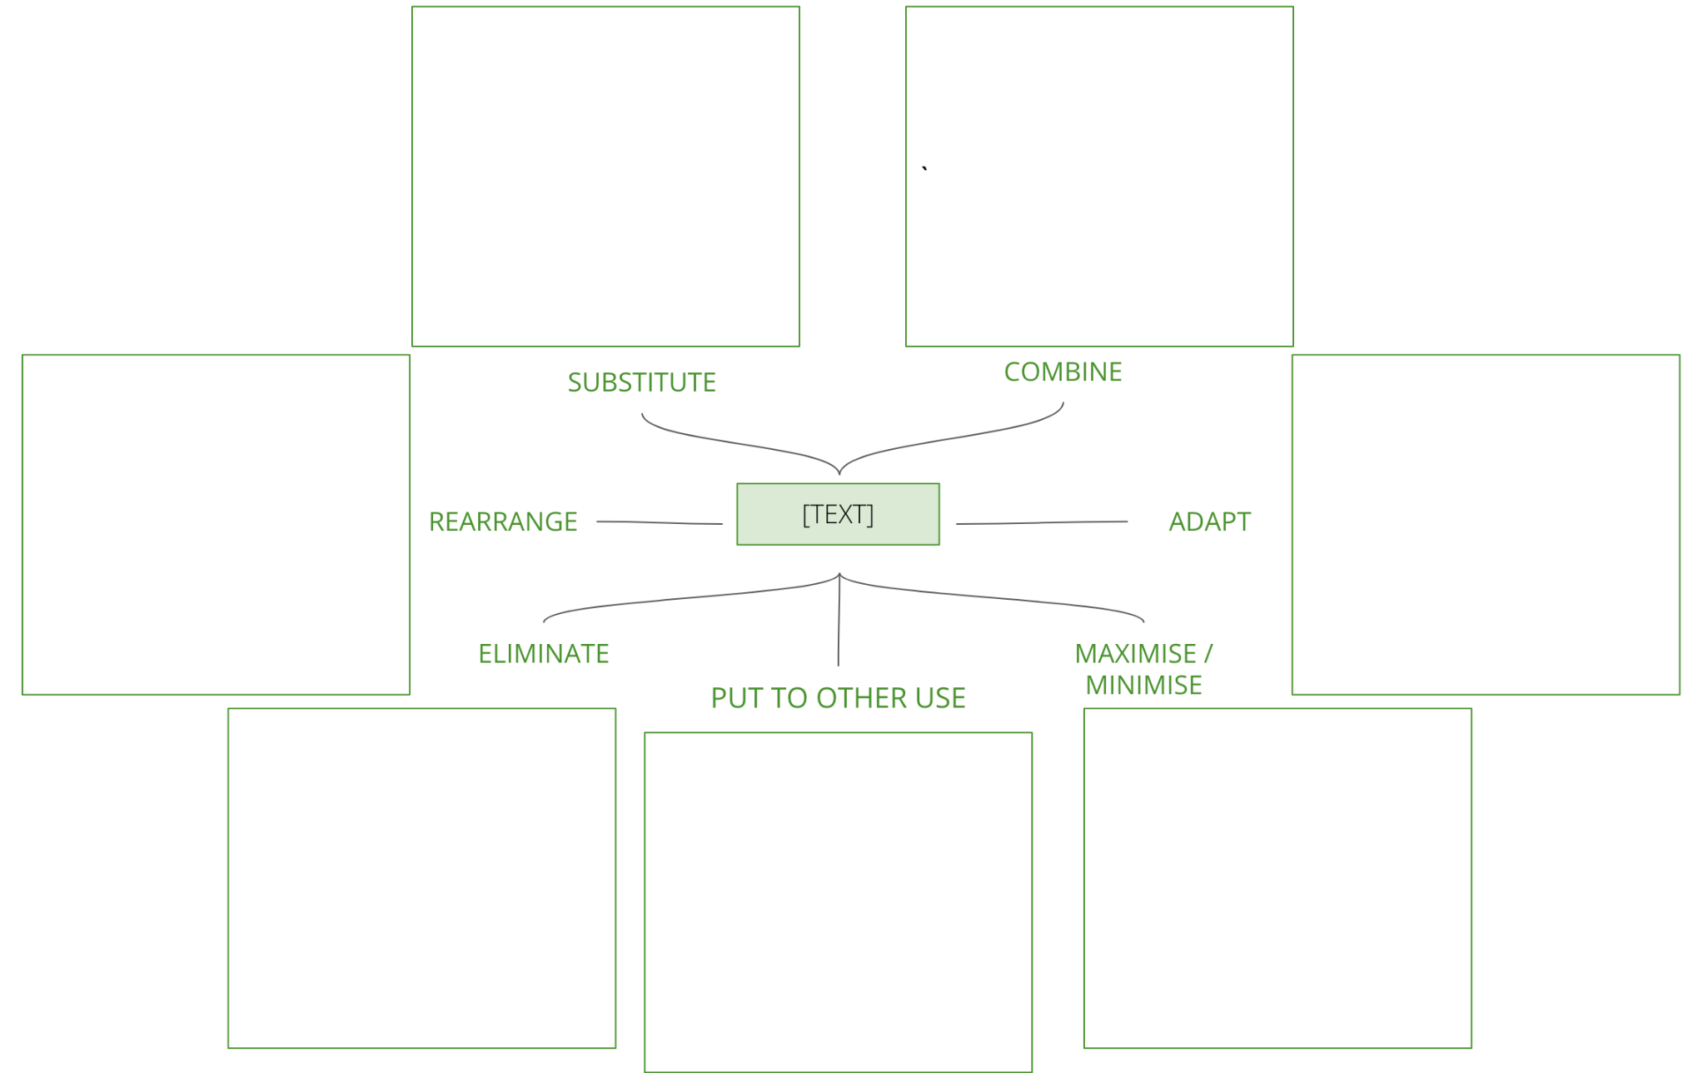
I want to come up with some simple and achievable new ideas
To make quick progress on an innovation opportunity we’ve already recognised
SCAMPER
What is it
SCAMPER refers to a series of thought starters or provocations which help you to innovate on an existing product, service or situation by looking through different lenses.
When to use it
Prerequisite - your start point for this has to be a specific innovation opportunity i.e. a type of product you want to create for example a Individual Giving subscription product, or a legacy acquisition product. If you’re looking for inspiration, this is a simple and effective way to figure out what’s on the market already, what problems are being solved for your target audience, who’s doing it well and how.
Learn More
READ - Miro’s brainstorming exercises
LISTEN - Stephen Gates’ brainstorming podcast episode
There are seven provocation lenses in the SCAMPER method:
Substitute: what elements of this product or service can we copy?
Combine: how can we combine this with other products or services?
Adapt: what can we change to make it better?
Maximize or minimize: what features would we greatly enlarge or greatly reduce?
Put to other use: what completely different use could we have for this product?
Eliminate: what elements of the product or service don’t work?
Rearrange: how can we rearrange the product or reverse the process?

Slide 2
THE TEMPLATE
SCAMPER
There are seven provocation lenses in the SCAMPER method:
Substitute: what elements of this product or service can we copy?
Combine: how can we combine this with other products or services?
Adapt: what can we change to make it better?
Maximize or minimize: what features would we greatly enlarge or greatly reduce?
Put to other use: what completely different use could we have for this product?
Eliminate: what elements of the product or service don’t work?
Rearrange: how can we rearrange the product or reverse the process?

Slide 3
HOW TO USE IT
SCAMPER
STEP 1
Get a group of colleagues together for this exercise, you’ll need a few hours to prepare, and 2 hours to run the session. For this exercise to work, you must have a clear enough idea of the type of idea you’re trying to create that you can search for competitor products.
STEP 2
To prepare for the session, do some desk research into competitor products, if possible order them or sign up and collect the emails, physical content if applicable. Start by casting the net wide to get a good understanding of the competitive landscape, before honing in on the leading 3-5 products.
STEP 3
During the session, go through each of the top 3-5 products one at a time with the group. For each, go through each letter of SCAMPER and capture the ideas that come out on post it notes.
STEP 4
As a final exercise, create a list of desirable features or principles that you want to follow, i.e. personalisation to tailor the product to individuals, tiered pricing structures to offer flexibility, storytelling to engage your target audience with your brand.
STEP 5
Following the session, write up the key features and principles, with precedents listed for each. Are you able to combine these into a single idea? If so, use the idea template to capture as many different ideas as possible.

Slide 4
SCAMPER
Use this tool to take existing products, services or compaigns and turning them into something new. Print out the template. Post-it in each box
`
SUBSTITUTE
COMBINE
REARRANGE
[TEXT]
ADAPT
ELIMINATE
PUT TO OTHER USE
MAXIMISE / MINIMISE
Notes:
There are seven provocation lenses in the SCAMPER method:
Substitute: what elements of this product or service can we copy?
Combine: how can we combine this with other products or services?
Adapt: what can we change to make it better?
Maximize or minimize: what features would we greatly enlarge or greatly reduce?
Put to other use: what completely different use could we have for this product?
Eliminate: what elements of the product or service don’t work?
Rearrange or reverse: how can we rearrange the product or reverse the process?

Slide 5
Idea Name:
IDEA TEMPLATE
Use this template to write up the winning ideas from idea generation activities
ELEVATOR PITCH
WHAT FEATURES DOES IT HAVE?
What’s the essence of the idea?
Describe the idea in more detail
CUSTOMER BENEFITS
FUNDING MODEL
What will they gain? What pains will it solve?
How will the idea make money?

