Slide 1
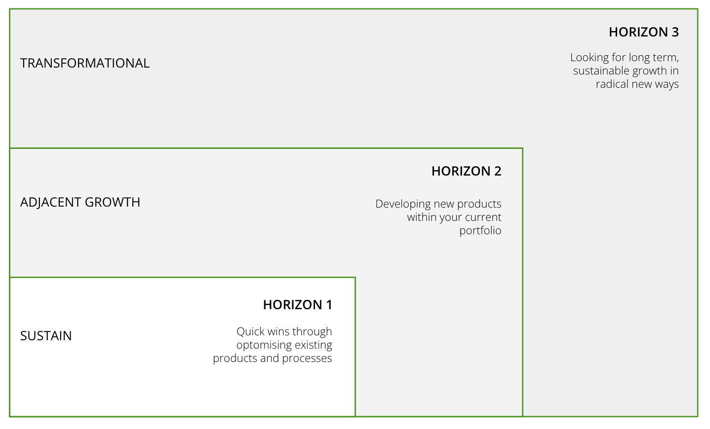
I want to create a balanced portfolio of innovation projects
to deliver both quick wins and longer term growth
3 HORIZONS OF INNOVATION
What is it
The 3 horizons model is a growth framework by McKinsey. It’s a simple 1 page tool to help your team visualise and prioritise your various innovation initiatives, ranging from quick wins through to more radical, long term opportunities.
When to use it
When you and your team are setting budgets, planning ahead and thinking about what projects you’ll undertake, when. Or when you’re creating an innovation pipeline and roadmap It will help to visualise and communicate your team’s grand innovation plan and the goals for that plan over time – including when you can expect to see return on investment, income, or impact.
Learn More
WATCH Board of Innovation explainer video
The framework is made up of 3 sections:
The y axis represents value (this could be income and/or impact) and the x axis represents time.
Horizon 1 innovations are generally short-term projects that use your existing capabilities. They typically generate results in >1 yr.
Horizon 2 innovations extend your capabilities to adjacent areas. These innovations might involve repurposing successful products for new audiences or adapting ideas that already perform well for other charities. They typically generate results in 1-3yrs.
Horizon 3 ventures are long-term innovation projects that leverage new capabilities. They generally produce results in 2-3+ years

Slide 2
THE TEMPLATE
3 HORIZONS OF INNOVATION
The framework is made up of 3 sections:
The y axis represents value (this could be income and/or impact) and the x axis represents time.
Horizon 1 innovations are generally short-term projects that use your existing capabilities. They typically generate results in >1 yr.
Horizon 2 innovations extend your capabilities to adjacent areas. These innovations might involve repurposing successful products for new audiences or adapting ideas that already perform well for other charities. They typically generate results in 1-3yrs.
Horizon 3 ventures are long-term innovation projects that leverage new capabilities. They generally produce results in 2-3+ years

Slide 3
HOW TO USE IT
3 HORIZONS OF INNOVATION
STEP 1
If you’re meeting in-person, print the template on an A3 or A2 sheet of paper. If you’re running this virtually, create a Miro or Mural board for everyone to use. Best to use post-its to move ideas around as the discussion evolves.
STEP 2
Have your team’s long list of potential innovation opportunities to hand.and your latest strategy to refer to. From the strategy, ensure everyone is clear on the must-wins, business impact expectations, and timing around innovation outcomes.
STEP 3
Have a critical discussion about projects that could maintain or strengthen your existing products as Horizon 1. For these projects, discuss what your team is intending to achieve and by when.
STEP 4
Discuss the types of projects that will involve expanding your current portfolio of products. Will your idea generate substantial income in the near to medium future? Do you need an investment to make it happen? Plot your project types under the Horizon 2 curve accordingly.
STEP 5
Discuss your appetite to pursue transformational income opportunities to deliver sustainable growth down the road. Map your strategic intent under the Horizon 3 curve on post-its.

Slide 4
THREE HORIZONS OF INNOVATION
Use this tool to map out opportunities against the three horizons of growth
HORIZON 3
TRANSFORMATIONAL
Looking for long term, sustainable growth in radical new ways
HORIZON 2
ADJACENT GROWTH
Developing new products within your current portfolio
HORIZON 1
SUSTAIN /
IMPROVE
Quick wins through optimising existing products and processes

