Slide 1
Innovation Champions Training
Workshop
January follow up
St John Ambulance
Insight & Co-creation Debrief
July 2022
Mark Master Masons | Ryan Williams – check with Victoria re current message
Notes:
What we did
Personas
What’s coming next

Slide 2
We’ve unearthed powerful insight to direct fundraising, comms and innovation moving forward
“I don’t really come across St Johns Ambulance in my daily life. They don’t advertise on TV as far as I'm aware. They’re one of those organisations I have grown up with, that I see as being in the background, and I know they’re there in the case of an emergency. I just think they’re overlooked and I’m not really sure what else they do.”
(Cold Prestige Positions participant)

Slide 3
After the challenge of the the last 2 years, your audiences are narrowing their focus onto issues closer to home. Their health, happiness and communities. As a national community based charity, you’ve never been more relevant
However, you have an awareness issue. People don’t know the extent of what you do, or that you’re a charity (even some of those that volunteer for you). You need to define how you articulate who you are and why people should give to you.
Both warm and cold audiences see you in the ‘crisis response space’ rather than healthcare. There is an opportunity to better position yourself as a crisis response charity and learn from what others are doing in the space (e.g. RNLI)
Despite the lack of awareness around what you do, you’re highly visible in the community but people don’t see you in action. You’re a bit like a distant uncle and need to grab attention. Communicate more and focus on ‘starting simple’, ‘being proud’, ‘being specific’, ‘being relevant’, ‘being human’ and ‘being modern’
While your priority audiences differ to an extent, there was consensus around what they’d like to hear more about. People are most interested in understanding more about your ‘work with youth’, ‘first aid at home’ and your ‘free first aid app’
In regard to fundraising, people are focused on crisis/emergency response in their communities in addition to their own personal risk. Explore driving giving through community messaging as well as the concept of investing in your future safety/protection. Specifically, your audiences are keen to support your ‘youth programs’, ‘volunteer training’ and ‘homelessness’
Once supporters are actively giving to St John Ambulance, they’re not taken on any sort of engagement journey and you;’re not deepening your relationship with them. As a priority, invest in developing a supporter journey across your portfolio
Building on the above, you’re fortunate to have a set of volunteers who are proud to work with you and give their time. However they feel unrecognised. As a priority, invest in building out a volunteer journey, centred around gratitude
Those audiences who are warm to you, are typically siloed in their engagement with St John Ambulance and have limited awareness of the other aspects of your work. Once you have a clear set of journey’s in place and now you know your audience motivations, the cross-sell opportunities will be significant.
We’ve uncovered a wide spread of insight across your priority audiences. Use the tools created to embed insight across the department, but you’ll need to continue to engage with your audiences and focus as you explore specific challenges

Slide 4
We heard a clear focus away from the chaos going on abroad - you’re a UK charity with great heritage
We heard a fear around a lack of investment in important infrastructure (like the NHS) - you’re often seen as the 4th Emergency service and support the broader emergency infrastructure
6 potential opportunities for St John Ambulance to better understand
We heard a strong engagement in local/community - you’re a community charity with a strong presence across the country
We heard ‘health’ being front of mind, both personally and collectively - you’re an emergency response charity that simultaneously offers large scale first aid training
We heard an emphasis on younger people and their potential - it’s your ‘year of youth’ and you specialise in youth training and development
We heard a desire for growth and self development - You have a host of training/resources to help up-skill the general public
Notes:
Whilst I am not overly worried about rising costs for myself, I am conscious that there are people across the country who are struggling to pay bills and feed their families

Slide 5
As suspected, your community presence allows you to meet people where they are and in a relevant way - however you need to stand out, be bold and communicate to get notice
Your audiences gave you guidance on how best to communicate - start simple, be proud, be specific, be human, be relevant and be modern
Awareness that you’re a charity in need of public funding is low (even among warm audiences) - you need to define what you stand for and why people should give to you
5 recommendations to take forward
Your warm audiences are typically siloed within one aspect of the work you do - the opportunity to cross-engage and ultimately cross-sell will be significant (we’ll explore this through co-creation)
Your audiences are very clear and consistent on what they'd like to find out more about - engage them in your work with you, your ‘at home training’ and ‘free first aid app’
Notes:
Whilst I am not overly worried about rising costs for myself, I am conscious that there are people across the country who are struggling to pay bills and feed their families

Slide 6
We know people are more likely to engage with you if they’ve needed your help- explore how you can solicit giving through positioning yourself as a safety-net for communities and future protection ‘in case’
Your audiences could pinpoint ‘best in class fundraising’ within the crisis response space - learn from RNLI and explore more hard-hitting and visceral campaigns
6 recommendations to take forward
Your warm givers don’t currently have an active relationship with St John Ambulance - build and implement a supporter journey using the recommended steps as a starting point
Your audiences are clear on the aspects of your work that they’d like to give to in the future - explore how you can fundraise around your youth programmes & volunteer training
Homelessness is as interesting area of your work that your audiences were keen to support - unpick whether there is the opportunity to fundraise around elements of your work in homelessness
Your volunteers are proud and passionate but lack recognition - they’ll do more for you and be your biggest advocate if you thank them
Notes:
Whilst I am not overly worried about rising costs for myself, I am conscious that there are people across the country who are struggling to pay bills and feed their families

Slide 7
All of this positions you a bit like a distant uncle who’s part of the family (but only just)...
…but you have permission to be so much more

Slide 8
But you need to fight harder to grab people’s attention
There was a strong universal sense that you need to be bolder, drive awareness (especially among younger people) and shout about what you do.
Our audiences identified 6 principles to help you drive attention…
…start Simple
People don’t know you’re a charity. Tell them what you do and why you need support
…be Specific
About what you do, the range of services you offer and most importantly what the benefit is
…be Proud
About the impact you make, and the lives you save. Celebrate the impact of your work
‘’
…be Human
You should have more access to ‘real stories’ than most, through your volunteers and the lives saved
‘’
Awareness of the organisation is really lacking. People need to know about all the great work they do, not just at events, but in hospitals, on the streets, training, and their work with you!
…be Modern
To engage younger audiences you need to meet them where they are - Youtube, Tiktok, Instagram
I need to better understand how what they do is different from the NHS. I get what the RNLI does because they do beaches and water. What’s St John Ambulance version of ‘saving lives at sea’
…be Relevant
Find a way to be relevant to people before they need your help in an emergency
Suburban Stability
Prestige Positions
Notes:
With the SJA, I need to better understand what they do that is different from when I call 999 and get an ambulance -- that is the key part. I get what the RNLI does because I get that they do beaches and water--the charity that helps save lives at sea. I don't think I could write a similar tagline for SJA.
To stay supporting it’s always good to get updates such as how May lives you’ve saved this year, how many people you’ve trained how you’ve spent the donations etc it would encourage me to keep giving.

Slide 9
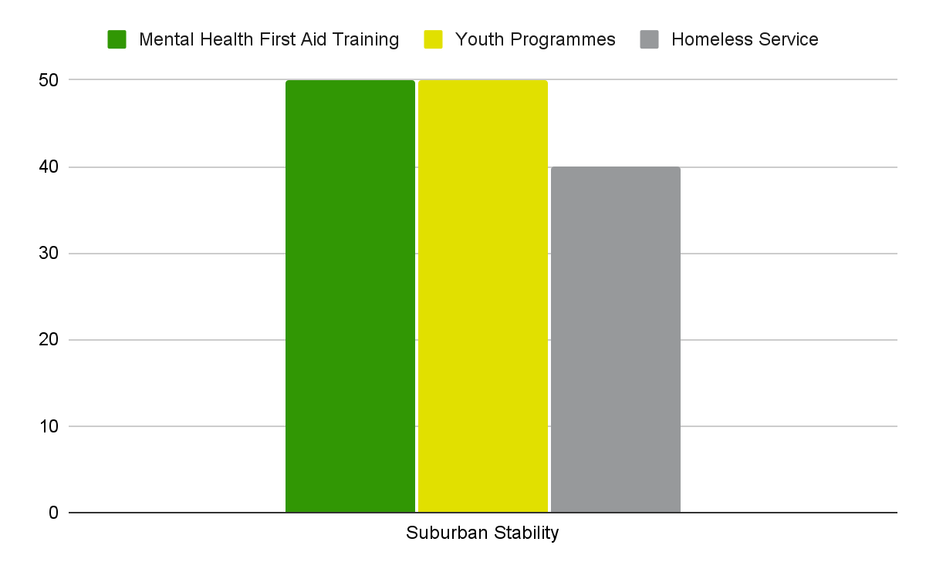
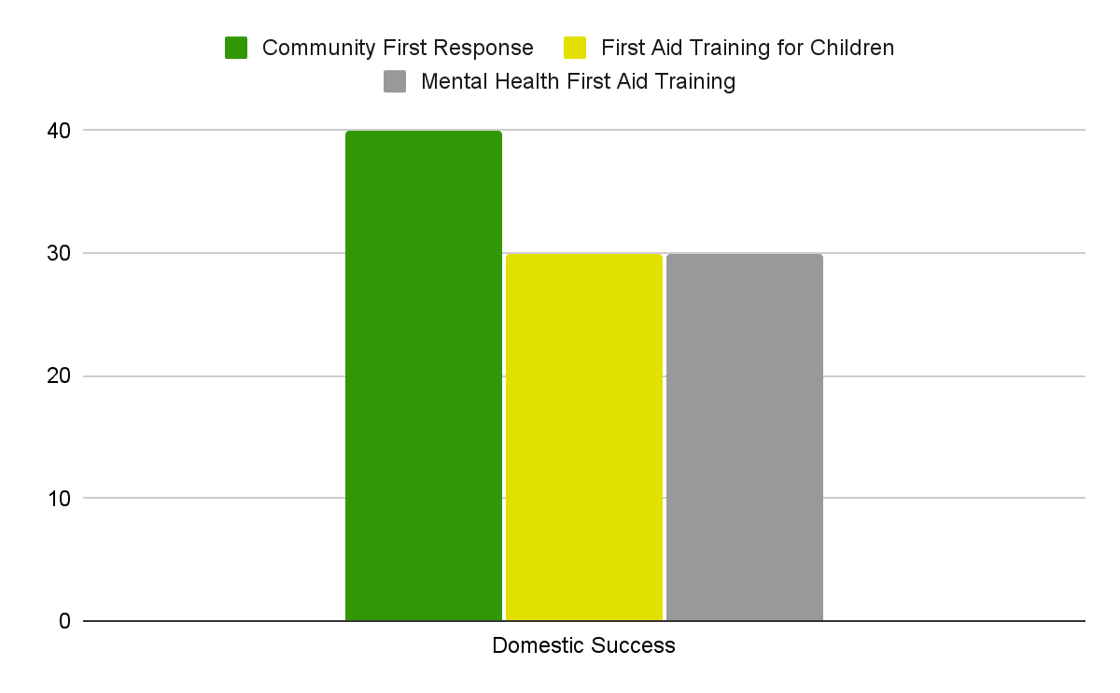
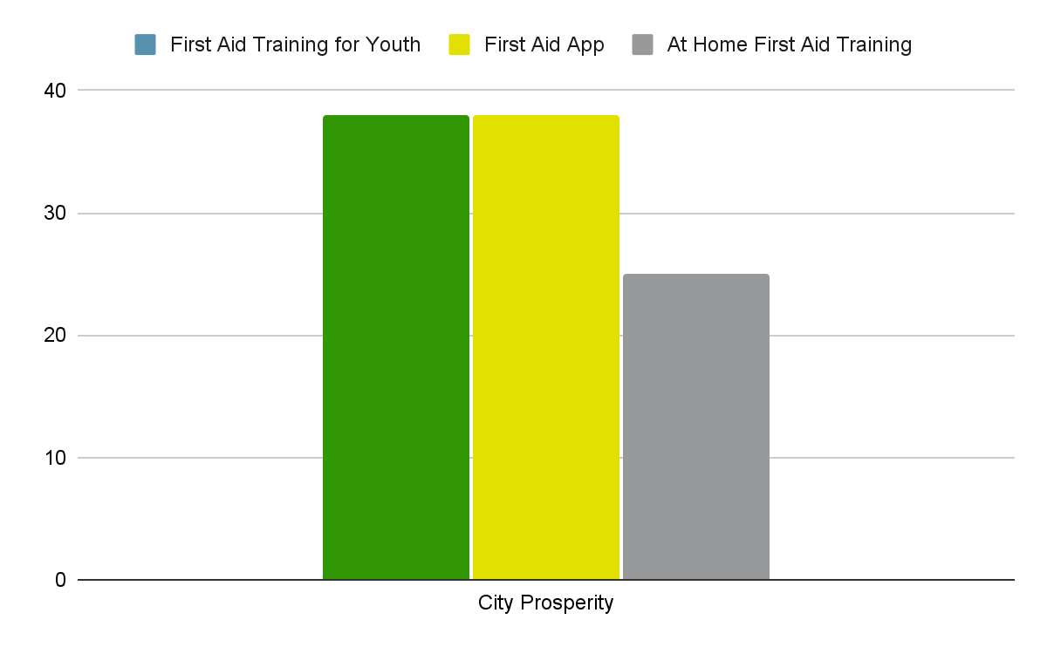
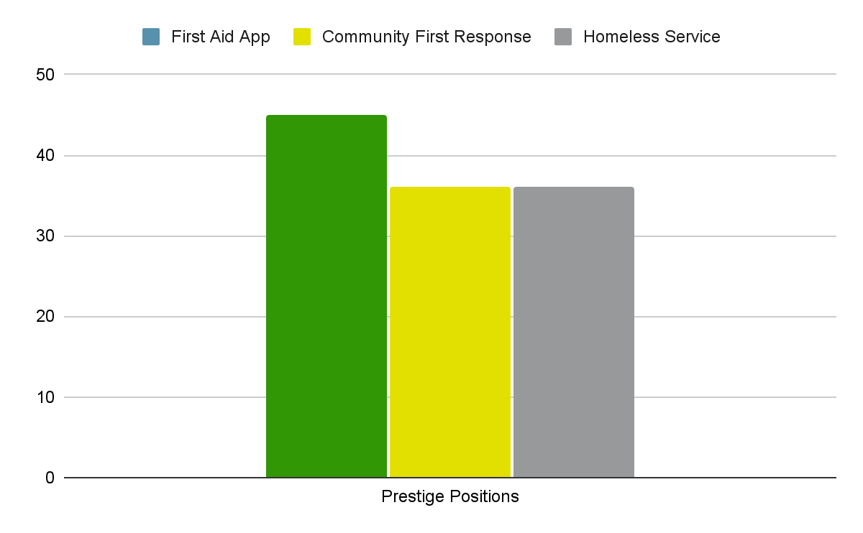
What should you be talking about…
…with limited knowledge of what you do, we asked our audience what they’d like to find out more about
‘’
‘’
I respect St John Ambulance. I often encountered them when competing in Horse Shows when I was younger. Kind people donate their time to be there when they are needed.
I know who St John Ambulance are as I’ve done first aid training through you. I feel the work they do is life saving, and it’s this aspect that first comes to mind.
Suburban Stability
Domestic Success
‘’
‘’
The main thing I think of when I hear the name St John's Ambulance is volunteers keeping revellers safe every weekend on the high street of the town I grew up in.
I don’t know a great deal about St John Ambulance. I believe they’re a charity-run ambulance service, but I don’t really know an awful lot about how they work or run.
City Prosperity
Prestige Positions
Notes:
Whilst I am not overly worried about rising costs for myself, I am conscious that there are people across the country who are struggling to pay bills and feed their families

Slide 10
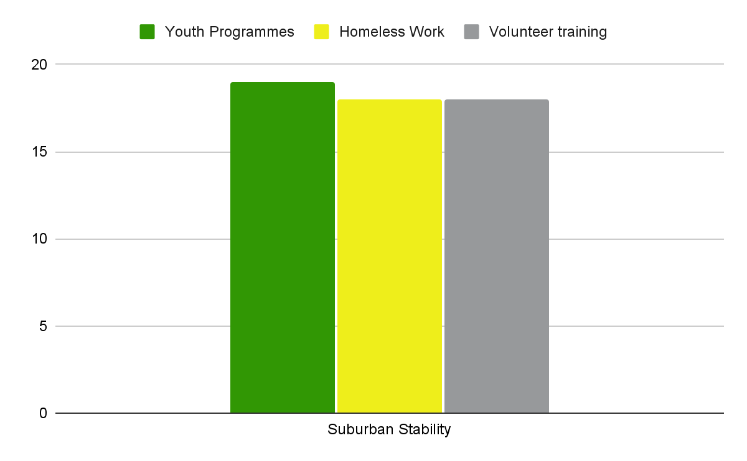
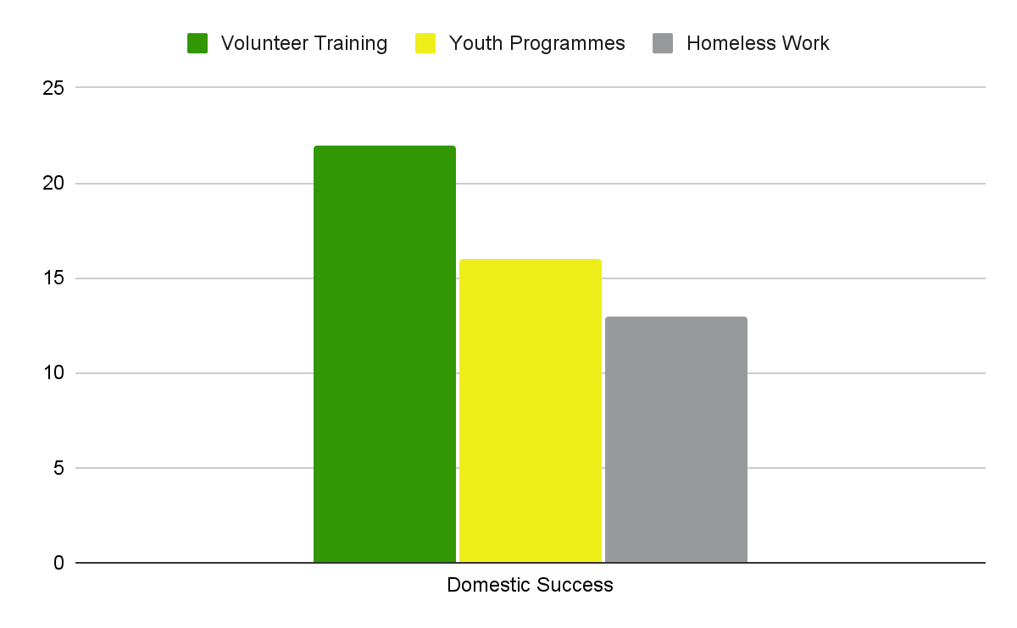
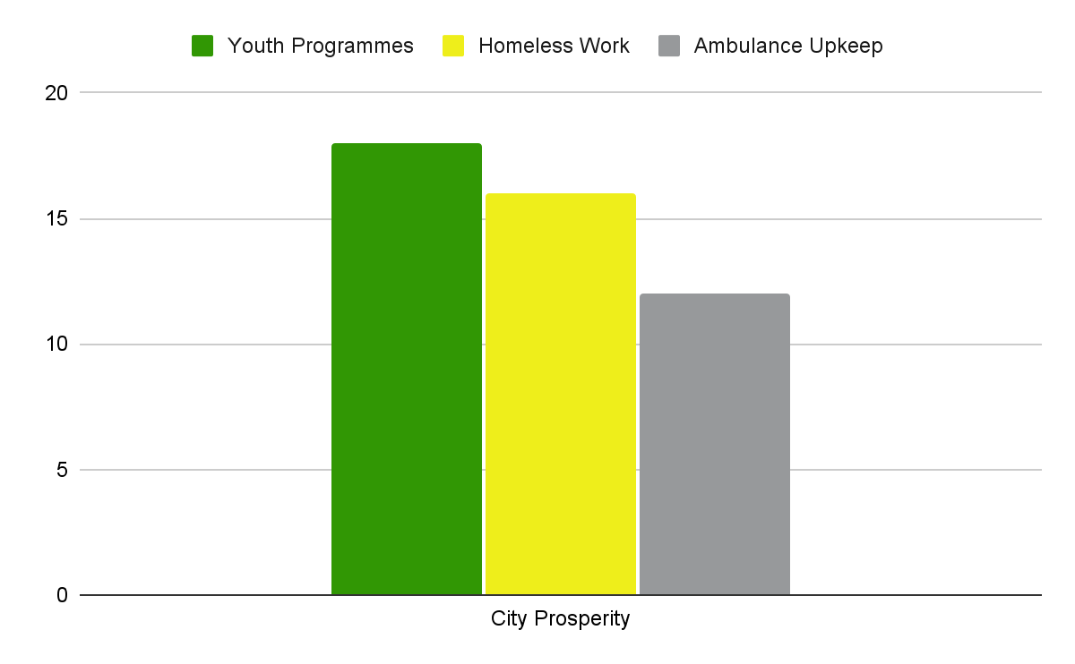
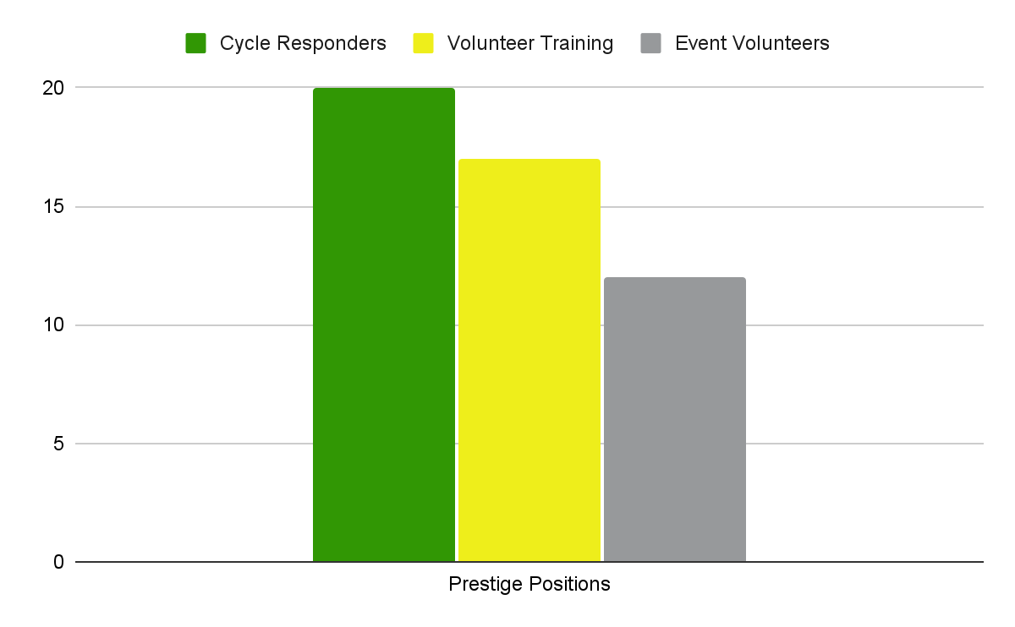
Going forward, your ‘warm’ and ‘cold audiences’ told us where they’d like to financially support St John Ambulance
.
Notes:
Whilst I am not overly worried about rising costs for myself, I am conscious that there are people across the country who are struggling to pay bills and feed their families

Slide 11
You’re colder audiences are typically stuck in the ‘know box’ while your warmer audiences are missing a ‘deep relationship’ with you
We know you’re colder audiences are aware of you but you’re very much in the background. However, your warmer audiences and existing supporters can’t typically recall their experience with St John Ambulance. There isn’t a strong sense of a journey or relationship with the charity.
.
‘’
I am not aware that I have received much information from you. A newsletter would be good, or an email bulletin with volunteering opportunities. That may help me to stay loyal to you longer, and I may even consider volunteering for you!
Warm Prestige Positions
KNOW
LIKE
TRUST
LOVE
‘I know the charity, but I tend to walk by’
‘I’ll donate clothes and give a gift if asked. I’m happy to actively support’
Opportunity to communicate more and better with colder audiences
Opportunity to build an engaging supporter journey
Notes:
Whilst I am not overly worried about rising costs for myself, I am conscious that there are people across the country who are struggling to pay bills and feed their families

Slide 12
But when evaluating a ‘cause’, there is a simple 2-step journey that people go on
The first step is to define the ‘cause space’ that you’d like to focus on (which is either planned or spontaneous), before applying 3 evaluation lenses to the options available
.
‘’
I decided to donate to them both because I care very strongly about the environment and these two charities did the best work on the ground, while publicising the issues.
Planned
Spontaneous
City Prosperity
Personal Experience
Thematic
Interest
Urgent
Need
‘’
The Archers Project is a local charity helping homeless people and they are so appreciative for donations and help vulnerable homeless people in Sheffield. Anyone could find themselves homeless!
Who’s the best charity tackling this issue?
Who’s having the biggest impact/who’s making the biggest claims/who’s in the news?
A
Who’s underrepresented but inspiring ?
Who’s small and innovative/approaching an issue in a unique or nuanced way?
B
Domestic Success
Who’s local & tackling this close to home?
Who am I connected too? Who’s having an impact in my community?
C
Notes:
I am a scuba diver and diving Instructor and they have rescued many people in scuba diving community in the past and you just never know when you might need them

Slide 13
More specifically, your warm audiences had clear and consistent motivations for getting involved with St John Ambulance
Typically your warm audiences were engaging with you in 3 ways and we heard common and consistent motivations
Giving £ through direct debit & lottery
Volunteering as vaccine & community volunteers
Parents of youth programme children
1
2
2
Motivate by:
CONNECTION
Motivate by:
COMMUNITY
Motivate by:
CARE
Approached at home and felt a connection to St John Ambulance (First aid course, community, direct experience)
Giving time to be part of a community, learning new skills and having an impact. Great pride in being part of St John
Interestingly, in most cases the child was keen to get into a care/medical/healthcare profession from a young age
‘’
‘’
‘’
I once remember being at Villa park & talking to a first aider about an accident my father had had involving his hand the previous day - they treated him on the spot!
It is just great having the people contact, ‘the ‘oldies’ want to tell you their life story, and last year some people just hadn't been out - some quite moving experiences
My little girl was 9 and she’s always wanted to be a doctor, she begged me to sign-up to one of your programmes

Slide 14
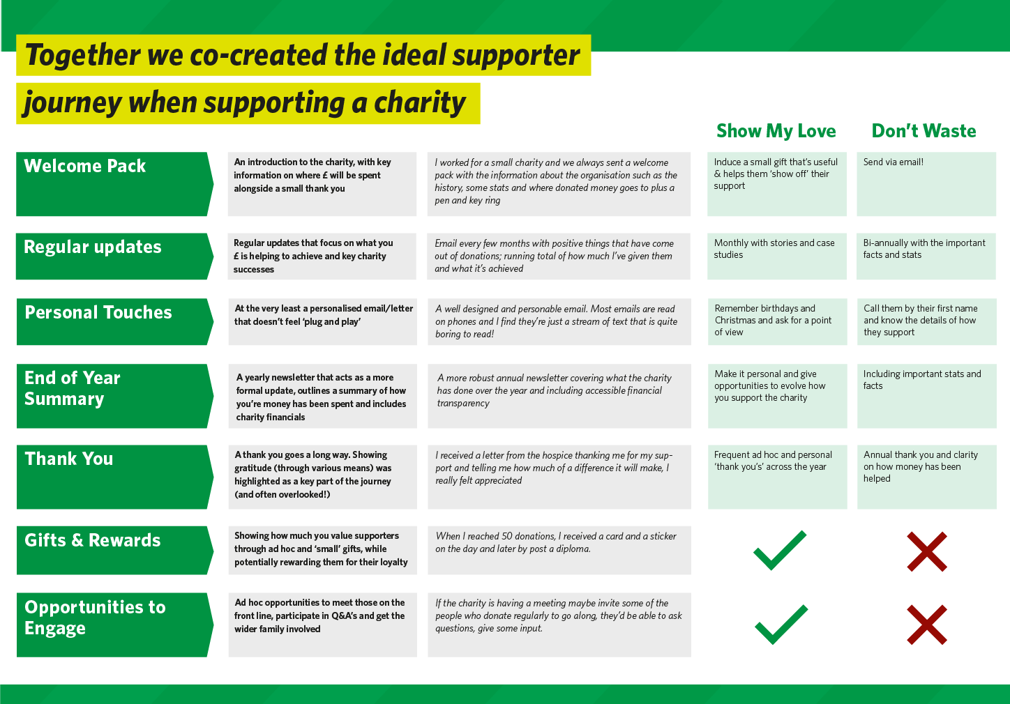
Notes:
Whilst I am not overly worried about rising costs for myself, I am conscious that there are people across the country who are struggling to pay bills and feed their families

Slide 15
Notes:
Whilst I am not overly worried about rising costs for myself, I am conscious that there are people across the country who are struggling to pay bills and feed their families

Slide 16
Notes:
Whilst I am not overly worried about rising costs for myself, I am conscious that there are people across the country who are struggling to pay bills and feed their families

Slide 17
Even your warm audiences are typically only interacting with a very specific area of your work
We didn’t come across any ‘warm audience’ members who had a clear and holistic understanding of what you do as an organisation.
There is still very little awareness around the multiple areas of your work and a real lack of cross-pollination across the charity.
Parents who had a child in the cadets will typically only know about cadets, even volunteers who are closer to your work have limited awareness.
Despite this, there is a real appetite to be better informed (and this would drive engagement and involvement)
Volunteers
Cadets
Training
‘’
I am a fairly well-informed person but I had no idea how much St John Ambulance do. Even just giving the location of the local Group HQ may spark interest and a sense of community.
Cold Suburban Stability
Notes:
I thought they were part of the NHS that was like for private hire events, trainings, etc. rather than a separately run charity
Because they are always present at big events like marathons that raise money for charity I think it’s easy to forget they themselves are a charity.

Slide 18
This lack of understanding means people aren’t aware that you’re charity
Interestingly despite being associated with your volunteers, people don’t often make the link to you being a charity
You’re often viewed across two extremes - either perceived to be an extension of the NHS (and funded by statutory funding) or you’re perceived to be an expensive training resource (commercially funded).
‘’
I thought they were part of the NHS that was for private hire at events, rather than a separately run charity.
City Prosperity
‘’
They’re always present at big events like marathons that raise money for charity so I think it’s really easy to forget that they themselves are a charity.
Warm audiences have a better awareness of your volunteers but don’t put you in typical ‘charity bucket’
Colder audiences have almost no awareness that you’re a charity in need of public funding.
Domestic Success
Notes:
I thought they were part of the NHS that was like for private hire events, trainings, etc. rather than a separately run charity
Because they are always present at big events like marathons that raise money for charity I think it’s easy to forget they themselves are a charity.

Slide 19
However, you’re very much seen as a trusted, heritage brand (especially by your older segments)
Your audiences are aware you’ve been around for a long time and that you’re British.
This history and heritage drives trust and a sense of gratitude. However, it does mean you’re not seen as a fashionable or modern brand and you’re perceived to be more for the older generations
Focusing in…
Janet & Gary (SS) can remember seeing the St John Ambulance volunteers uniforms when they were children! They know you’ve been around for decades!
Joe & Anna (CP) don’t feel like you’re an organisation ‘for them’ and associate you with older generations
Notes:
Whilst I am not overly worried about rising costs for myself, I am conscious that there are people across the country who are struggling to pay bills and feed their families

Slide 20
And you’re typically associated with Crisis response not healthcare
However, there is an interesting tension. Those that come across you solely at events think of you as an emergency response organisation.
Those (typically warmer audiences) who know about your vaccination work or cadets see you more as a healthcare charity.
‘’
St John Ambulance have a presence at events like festivals and sporting events. They are a reassuring presence for the public - if something goes wrong, they are around in case of an emergency.
Prestige Positions
‘’
People often associate St John Ambulance purely with the event side of things which is obviously a big part of the work. It’s by no means the whole picture. It's the life saving part of this that I feel needs to be communicated well.
Focusing in…
Sue & Peter (PP) primarily see you out and about in the community, they view you as ‘crisis/emergency response’
Janet & Gary (SS) had a son that was a cadet and dream of him becoming a doctor. As a result they associate you a little more with ‘healthcare’
Domestic Success
Notes:
Whilst I am not overly worried about rising costs for myself, I am conscious that there are people across the country who are struggling to pay bills and feed their families

Slide 21
Within that ‘crisis response’ role, you’re recognised as an ever-present in communities
Despite a lack of understanding and awareness you’re an ever present.
For most you’re woven into the fabric of their local communities and you’re seen as a silent but invaluable safety net that’s ready to be called upon when needed
‘’
St John Ambulance makes me think of events, my grandmother used to go to craft shows when I was young, I nearly always went with her and there was a St John Ambulance tent.
Suburban Stability
‘’
Focusing in
I was at a concert last night and I saw the team from St John Ambulance. They are a constant reassuring presence at such events and wider community actions.
Joe & Anna (CP) still see you as part of the community, even in Leeds! They see you at concerts and big public events that they attend.
Karen & Steve (DS) are grateful you’re there for their kids in situations when they’re not around (you give them peace of mind!)
City Prosperity
Notes:
Whilst I am not overly worried about rising costs for myself, I am conscious that there are people across the country who are struggling to pay bills and feed their families

Slide 22
But you’re not really visible anywhere else, people don’t remember seeing you try to grab their attention
We explored memorable charity marketing/comms campaigns with our audience and for the most part they had no recollection of seeing St John Ambulance in the media.
We tried to gather any feedback on your ‘Ask Me’ campaign but no-one (Warm or cold) could remember seeing it.
There was a sense that you’re not actively looking to promote who you are or the work you do and this helps to reinforce assumptions that you’re not a charity (Asking for money!)
‘’
I don’t think I’ve ever seen St John Ambulance advertised anywhere, they don’t do that sort of thing I imagine.
Suburban Stability
‘’
What’s their slogan? Where are they on social media? What do they stand for? What do they need from me? I don’t ever remember seeing them out there in the world!
City Prosperity
Notes:
Whilst I am not overly worried about rising costs for myself, I am conscious that there are people across the country who are struggling to pay bills and feed their families

